Slide 1

Accounts Receivable
project

Slide 2
TEAM MEMBERS
Evon Nady Thabet Morcos
Mohamed Khaled Mohamed
Mahmoud Mohamed Abdalhaliem
Yossra Ahmed Hosny
Ziad Mohamed Fathy
Asmaa Mohammed Hussien
Group Code: NXT14_ONL2_ERP4_S2
Under Supervision: ENG.Ahmed Elzahed
Company Name: Next Academy

Slide 3
PAYMENT TERMS

Slide 4
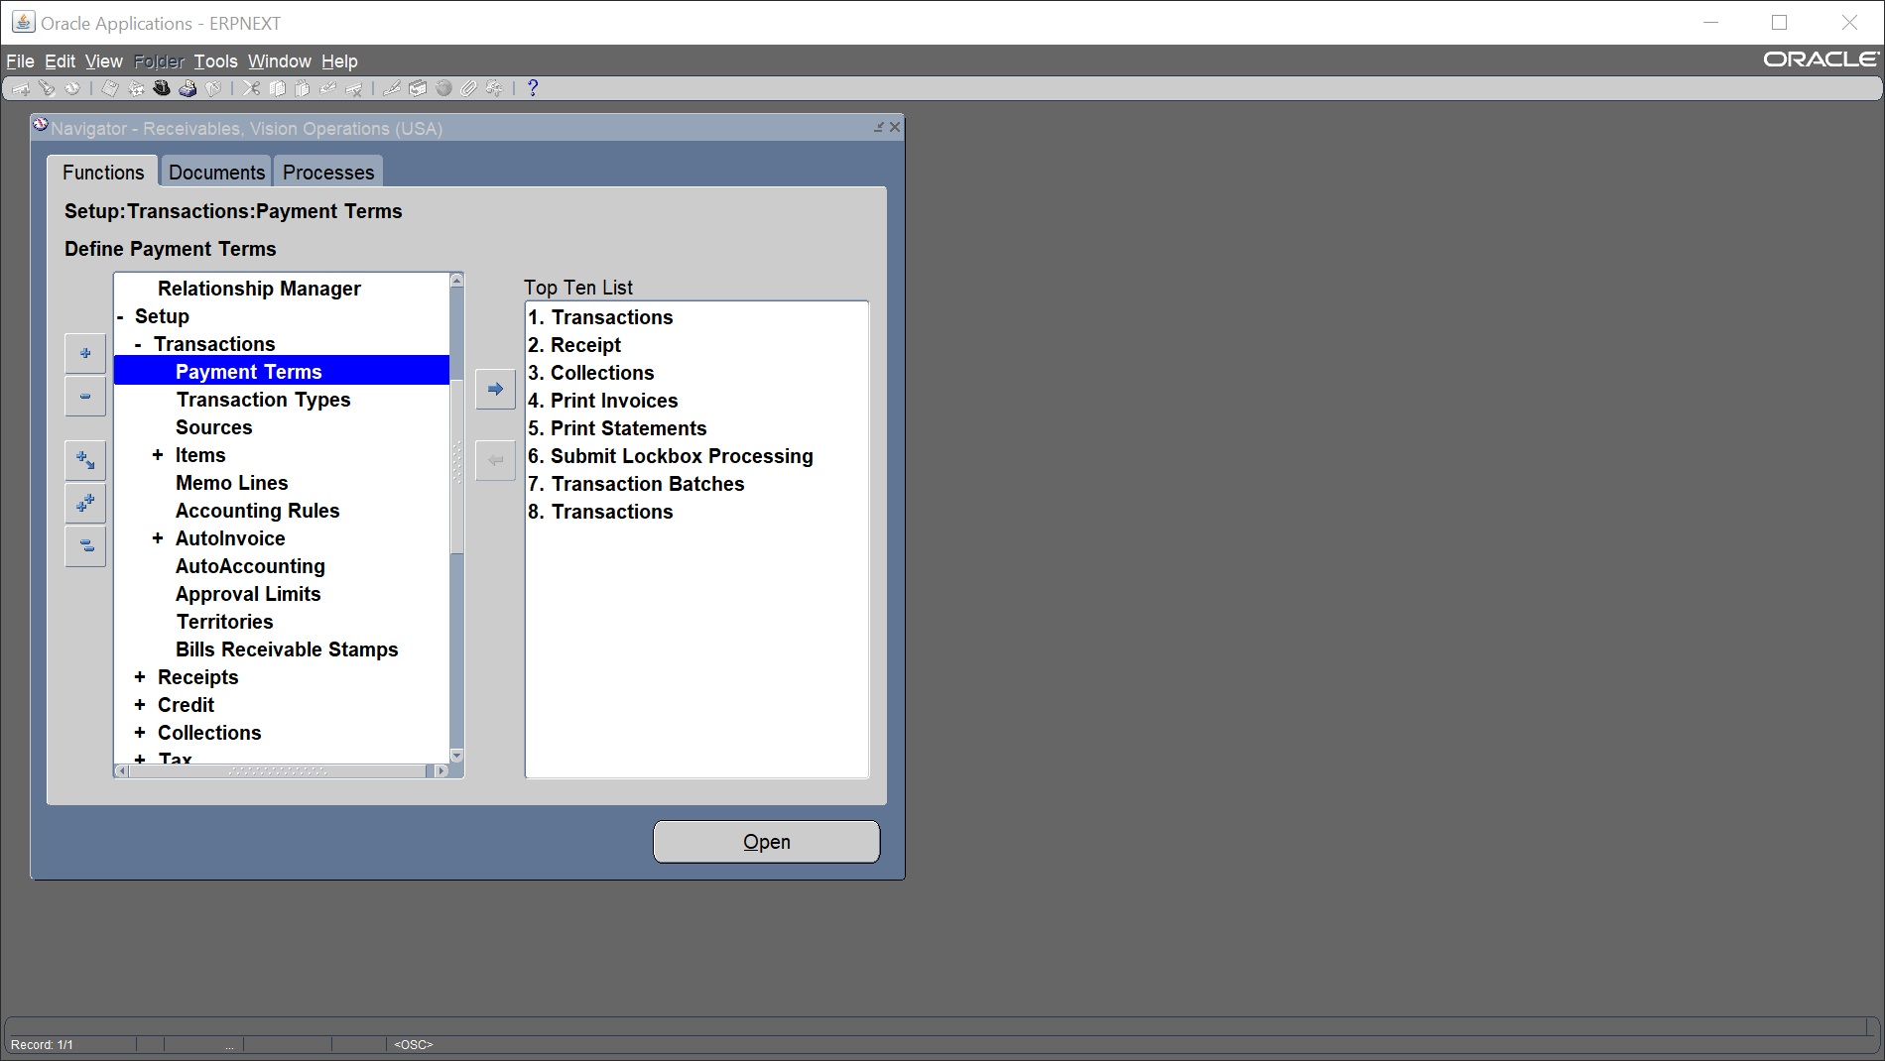
Payment Term
Setup
Transaction
Payment Term

Slide 5
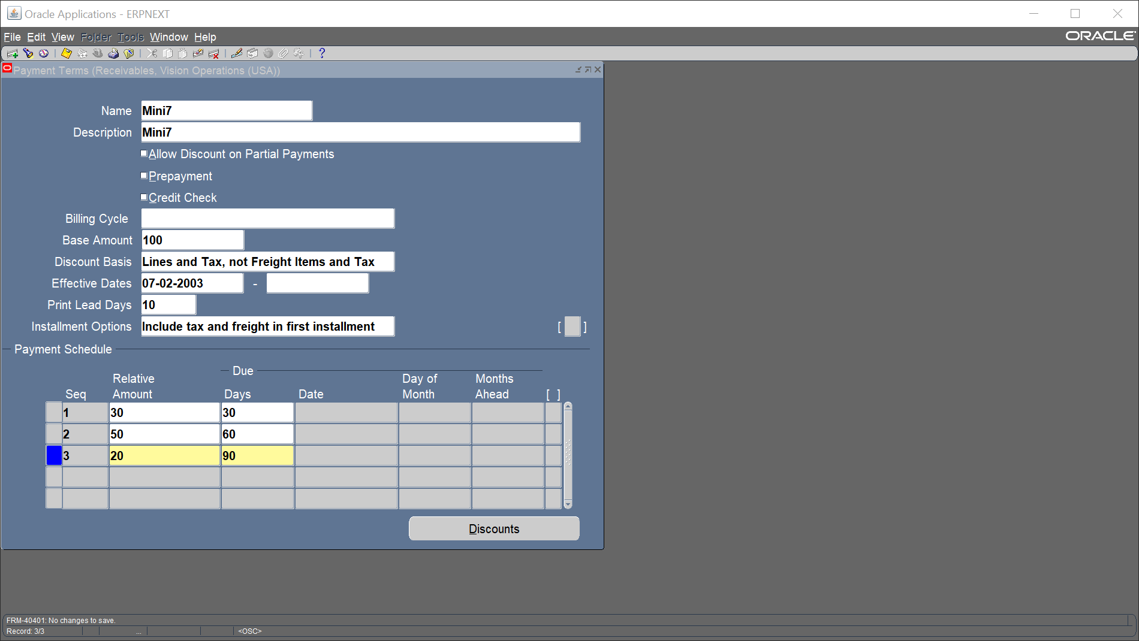
Add our name, description, base amount and our payment schedule

Slide 6
Create Manual Customer

Slide 7
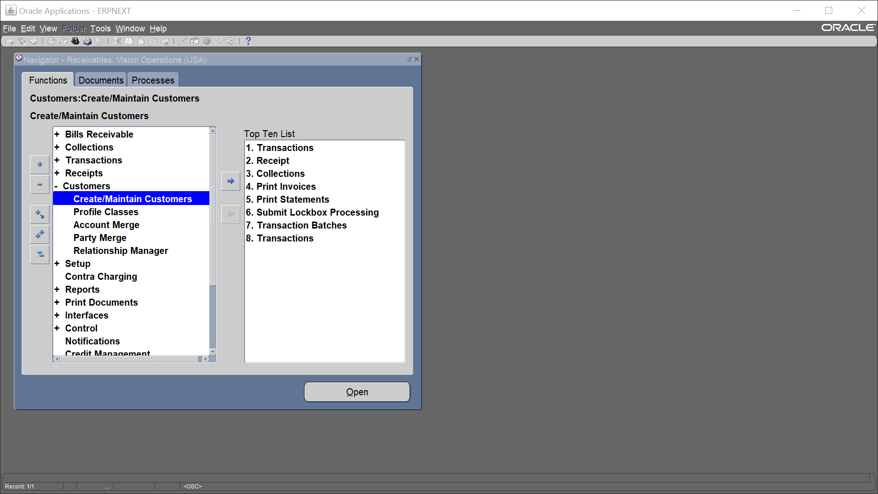
Create Manual Customer
Receivable Vision Operations (USA)
Customers
Create /Maintain Customer

Slide 8
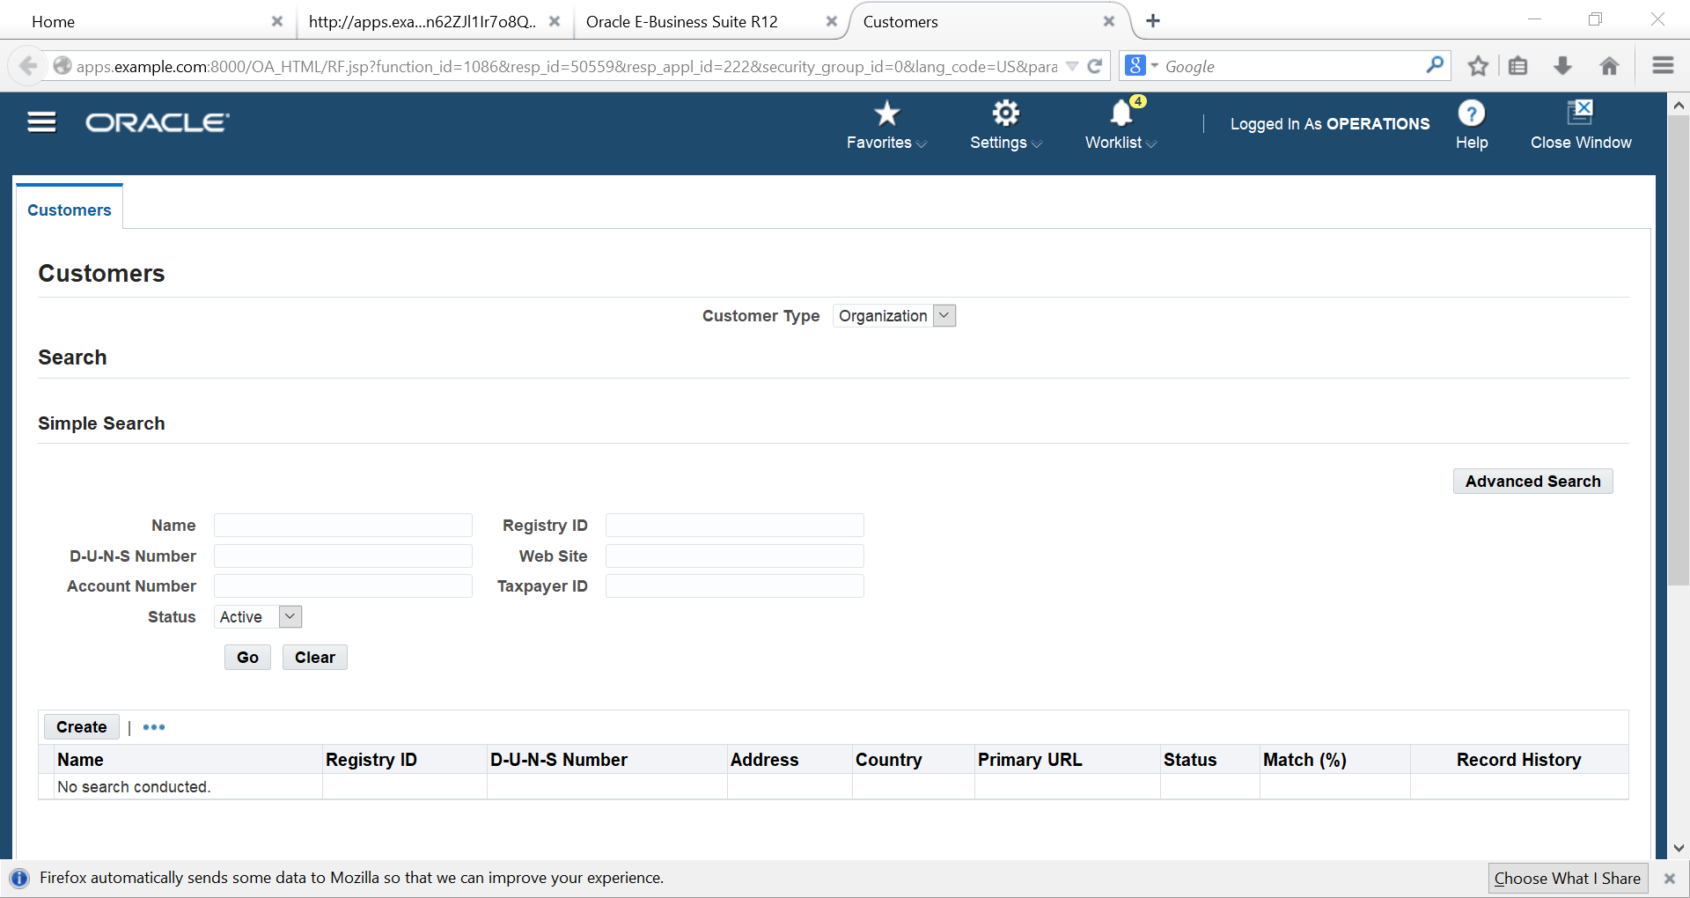
Create

Slide 9
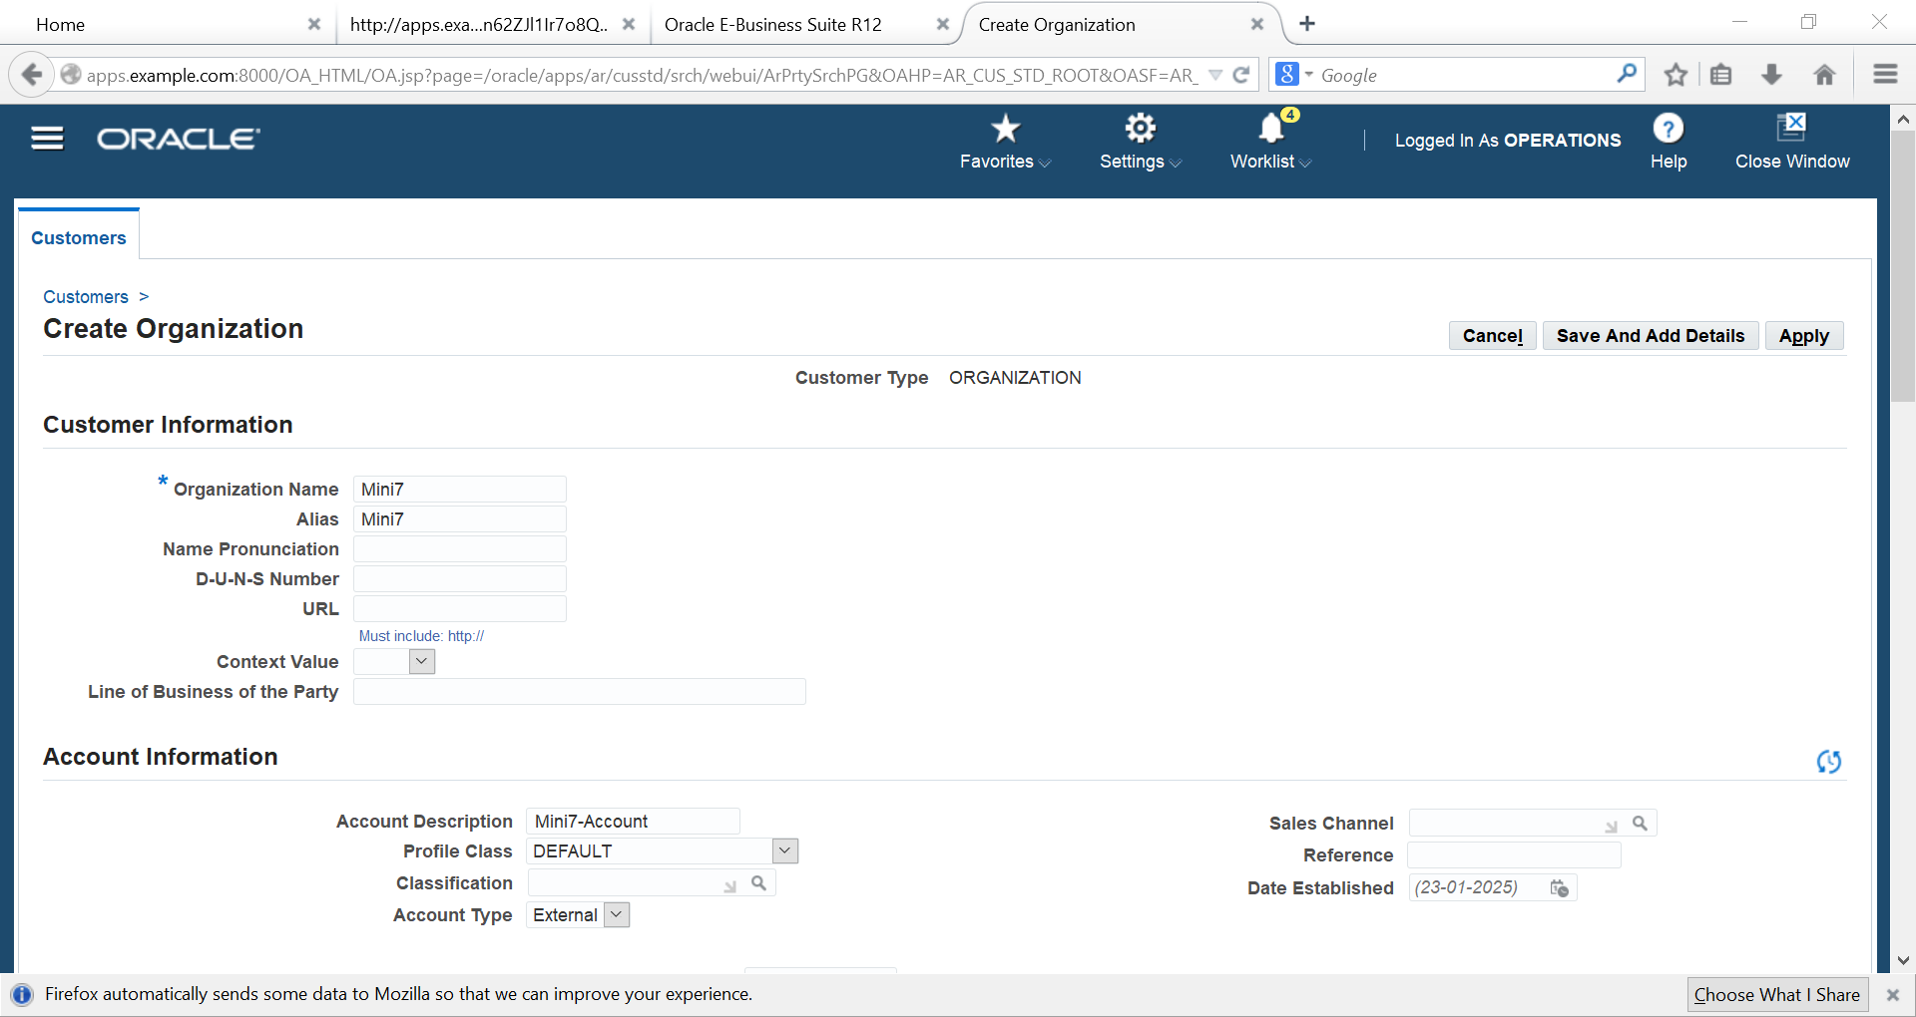
Add Name, Alias

Slide 10
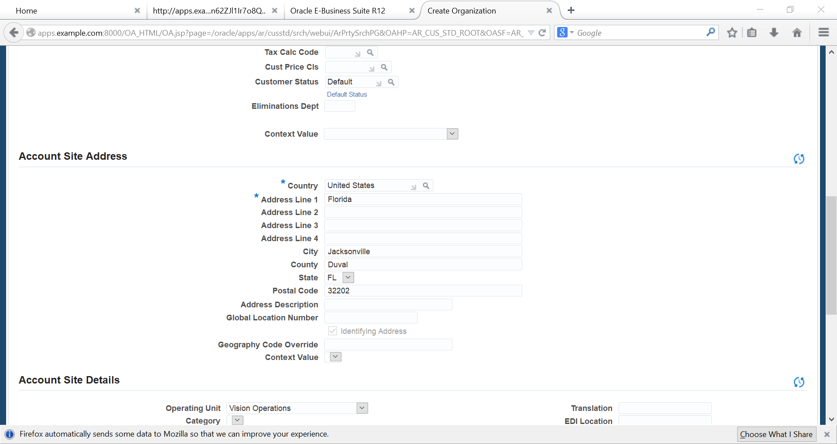
Add Country, Address, City, County, State, Postal Code

Slide 11
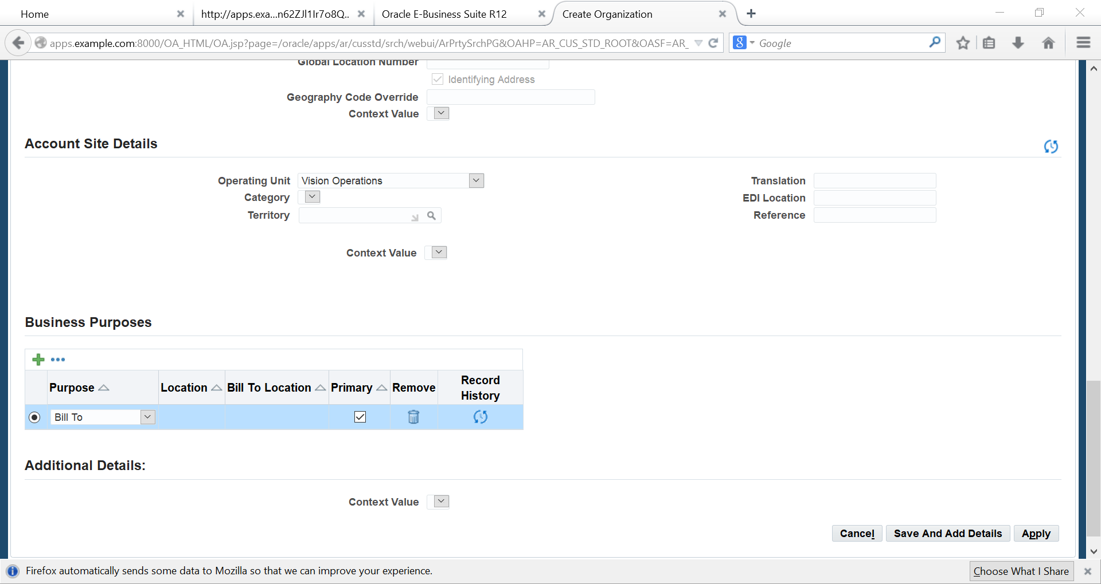
Primary, Apply

Slide 12
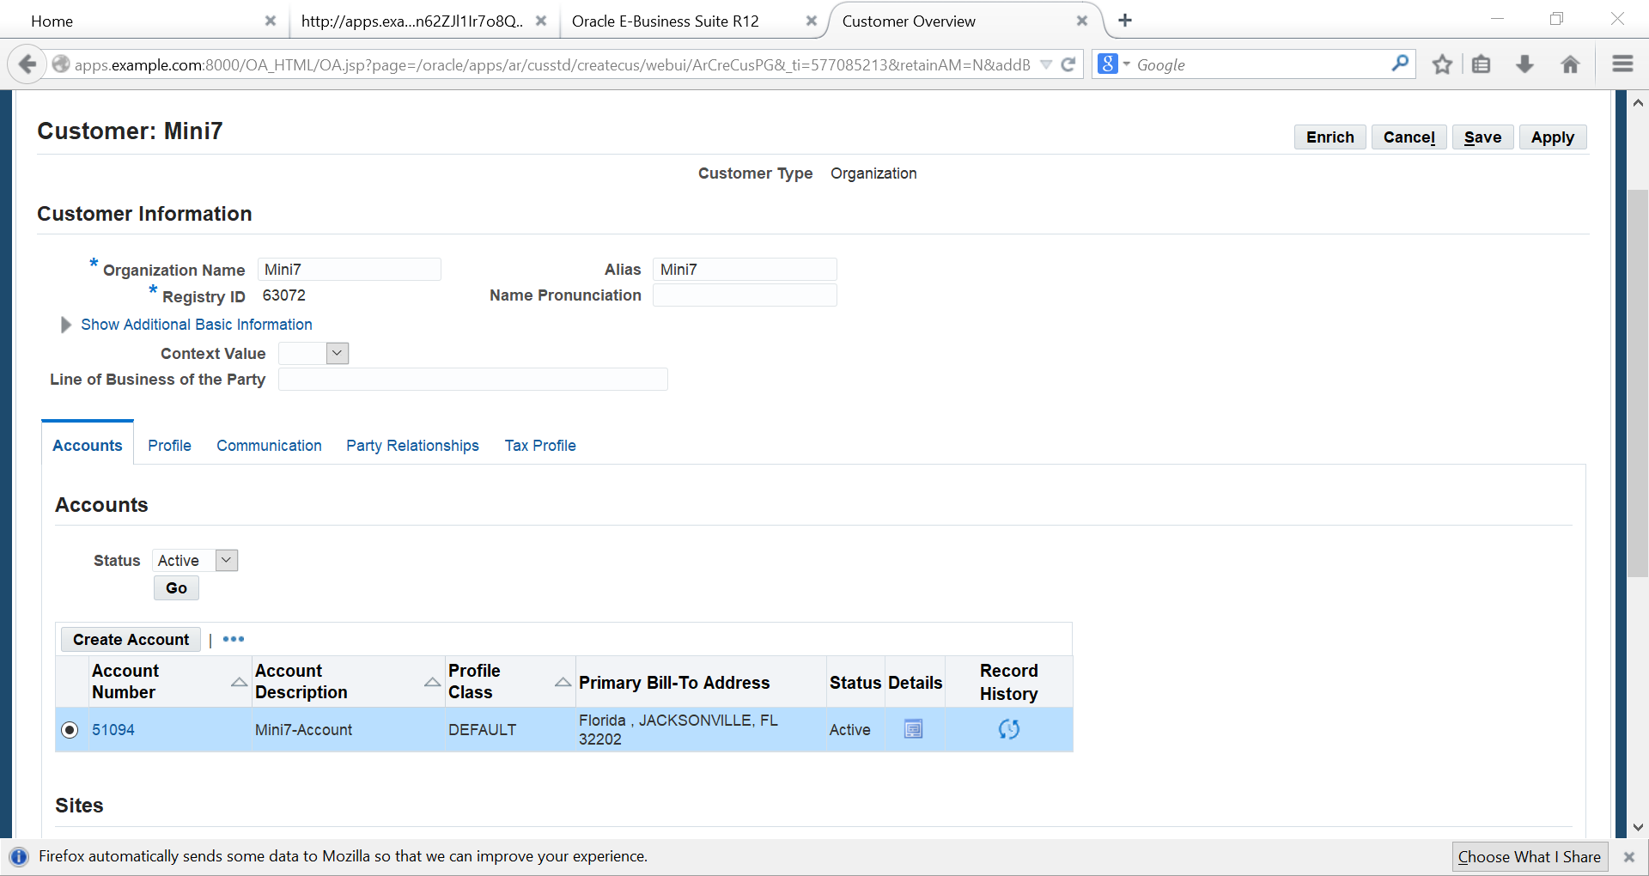
Choose our CUSTOMER

Slide 13
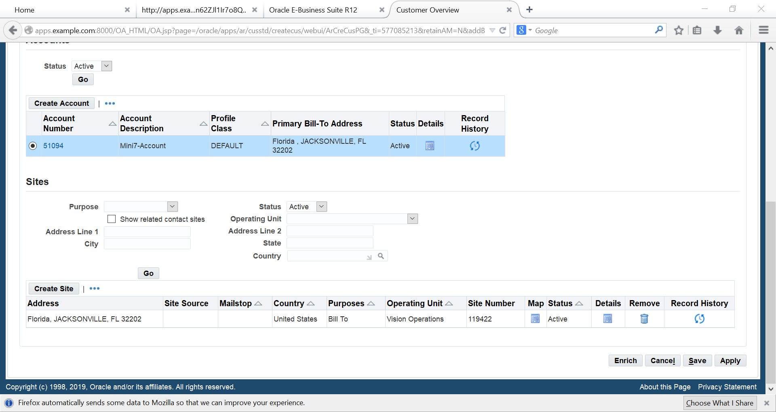
Click Details

Slide 14
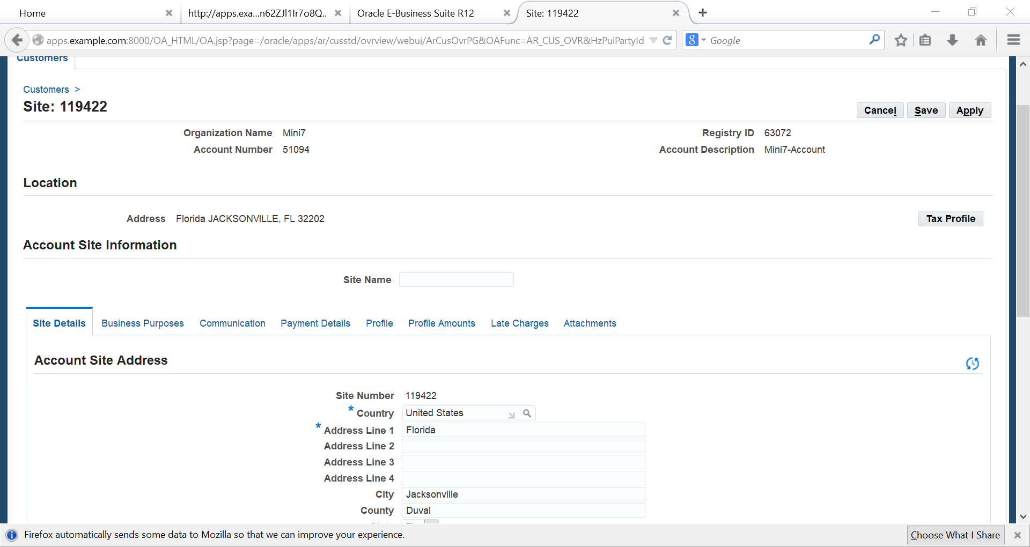
Business Purposes

Slide 15
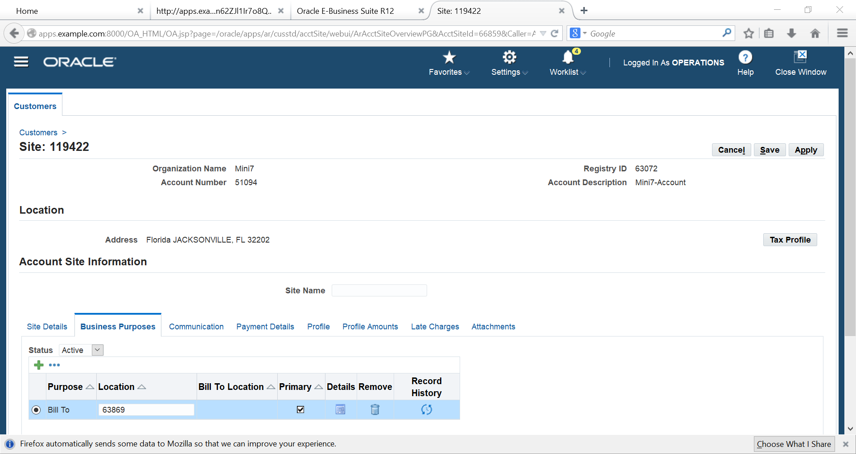
Detail

Slide 16
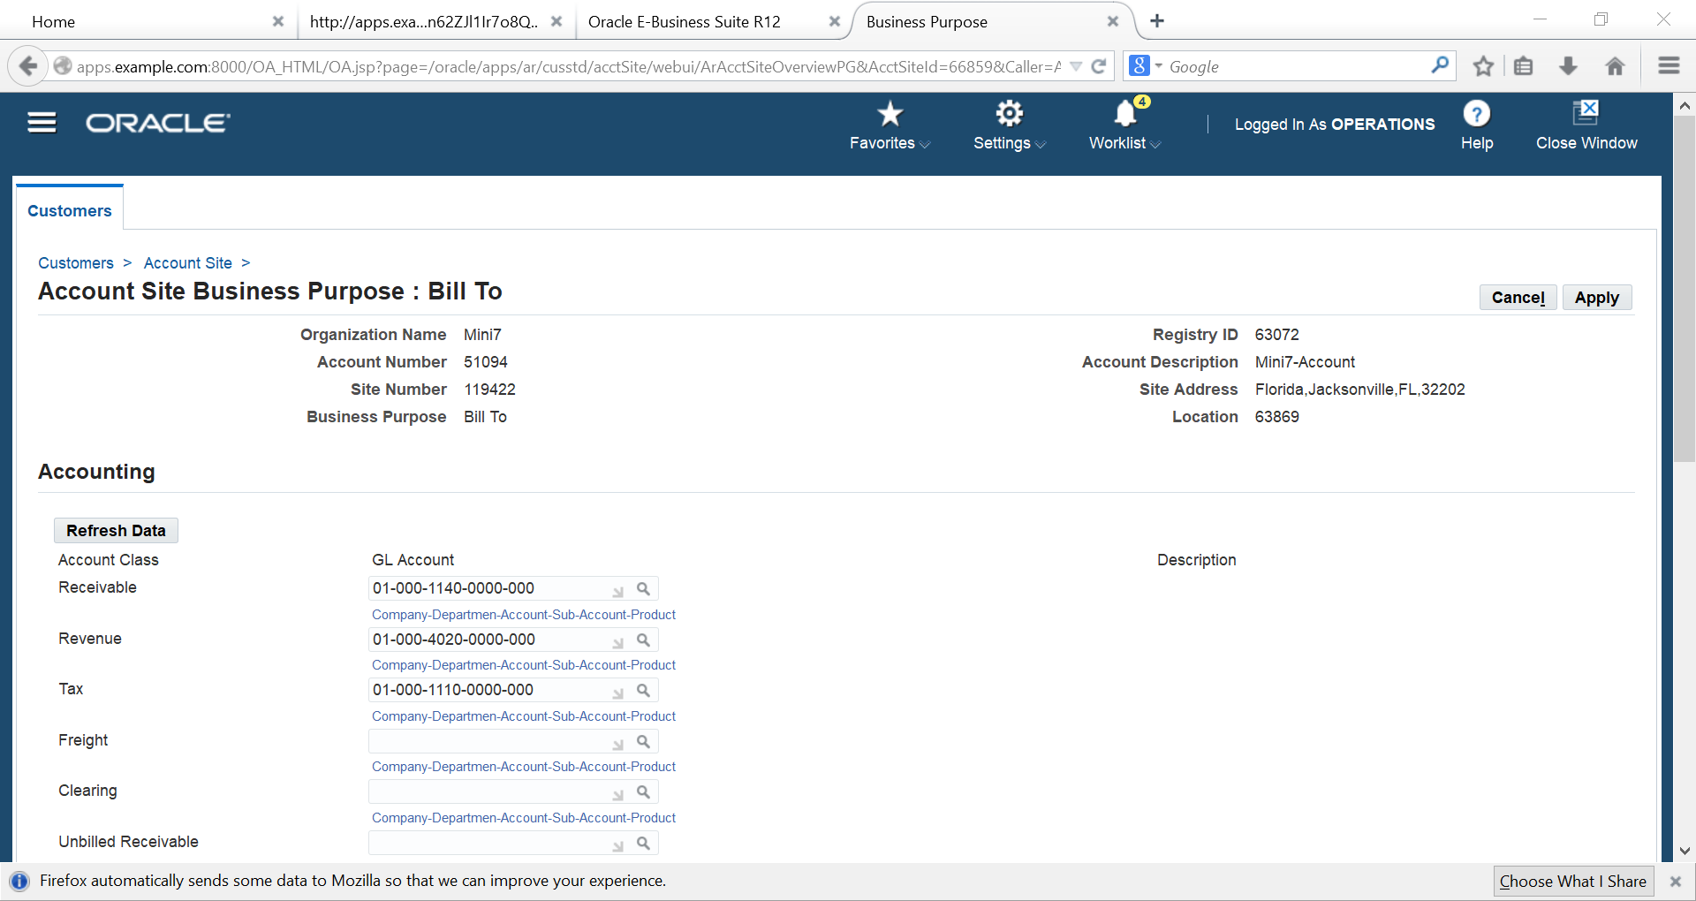
Adding accOUNT receivable, revenue and tax

Slide 17
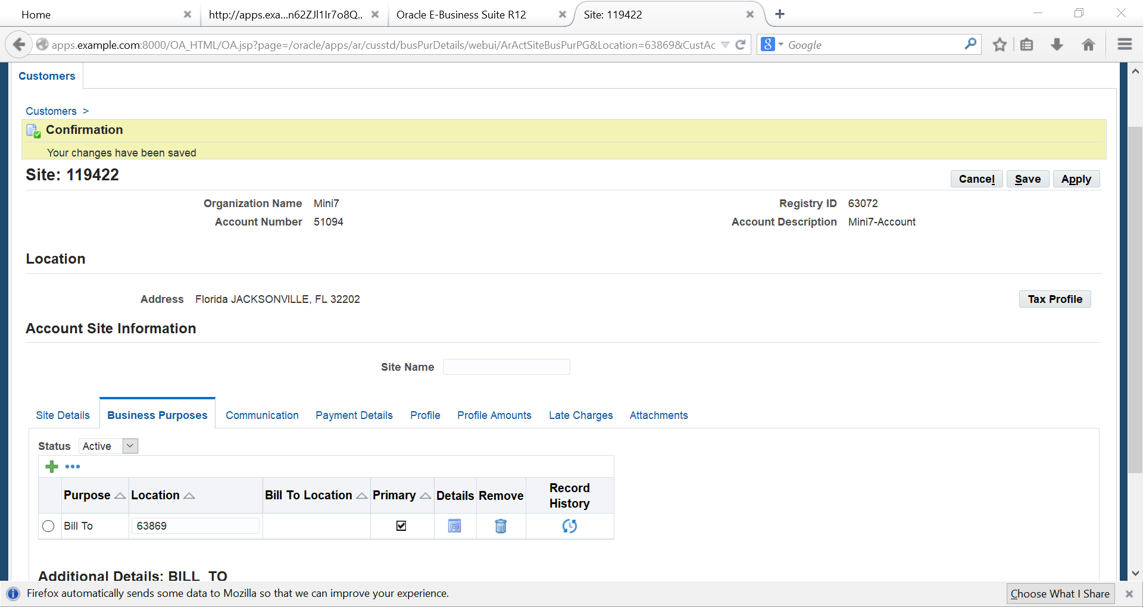
Tax Profile

Slide 18
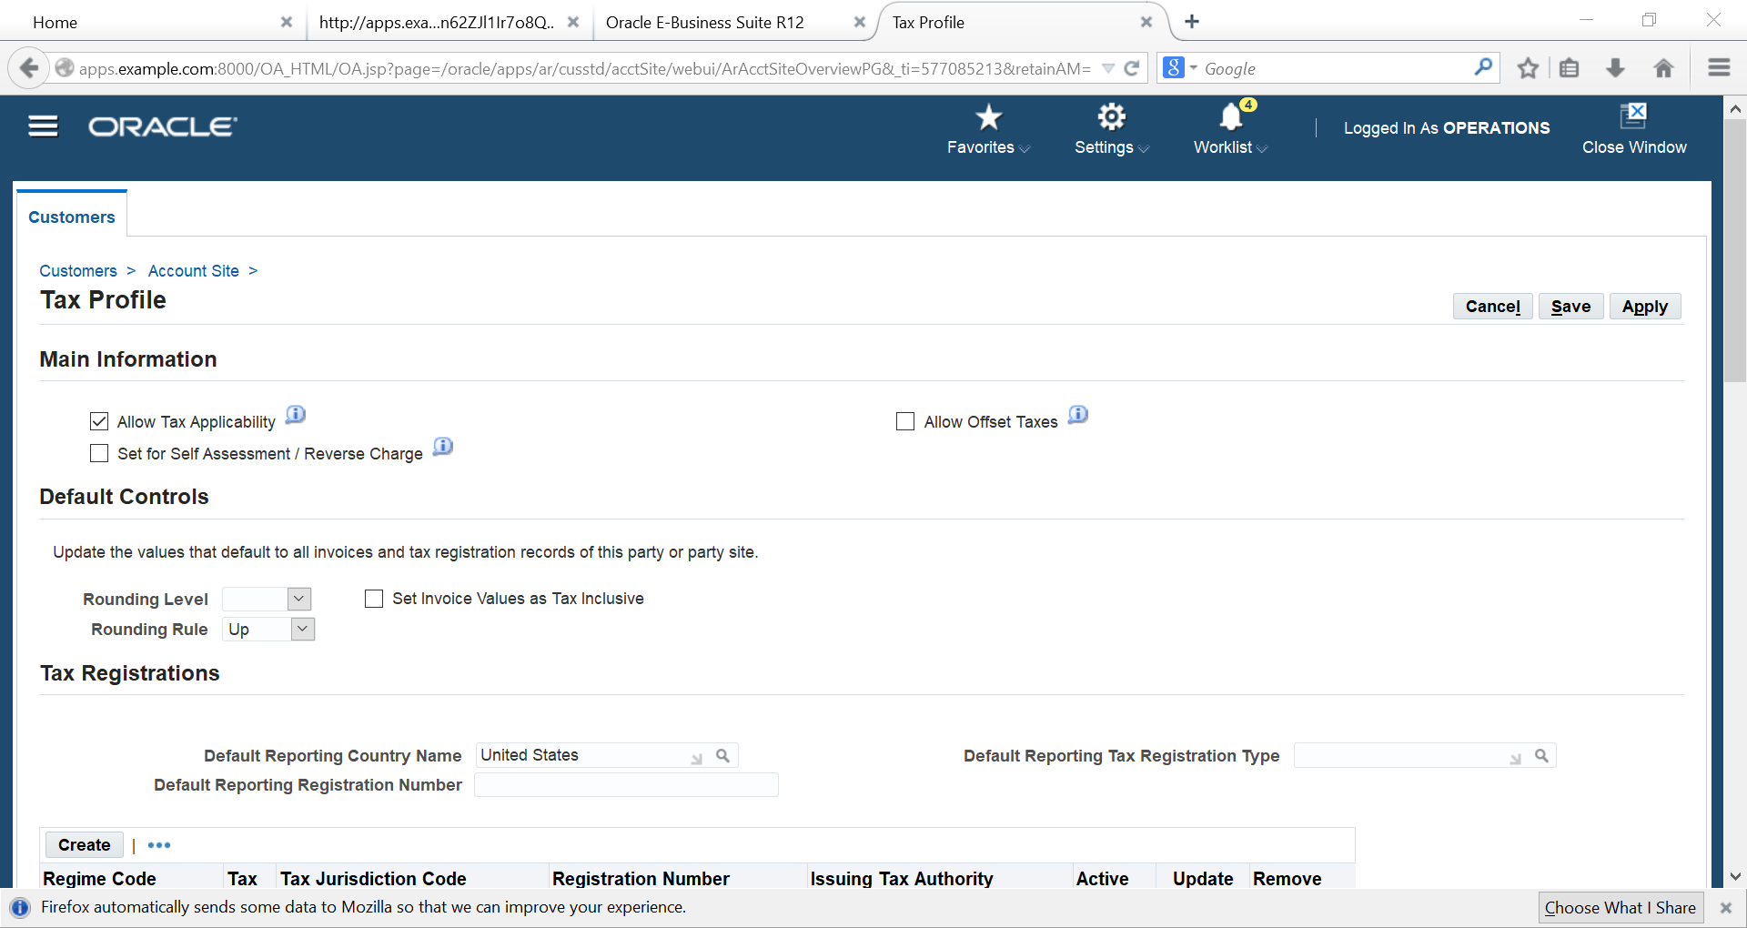
Allow Tax Applicability

Slide 19
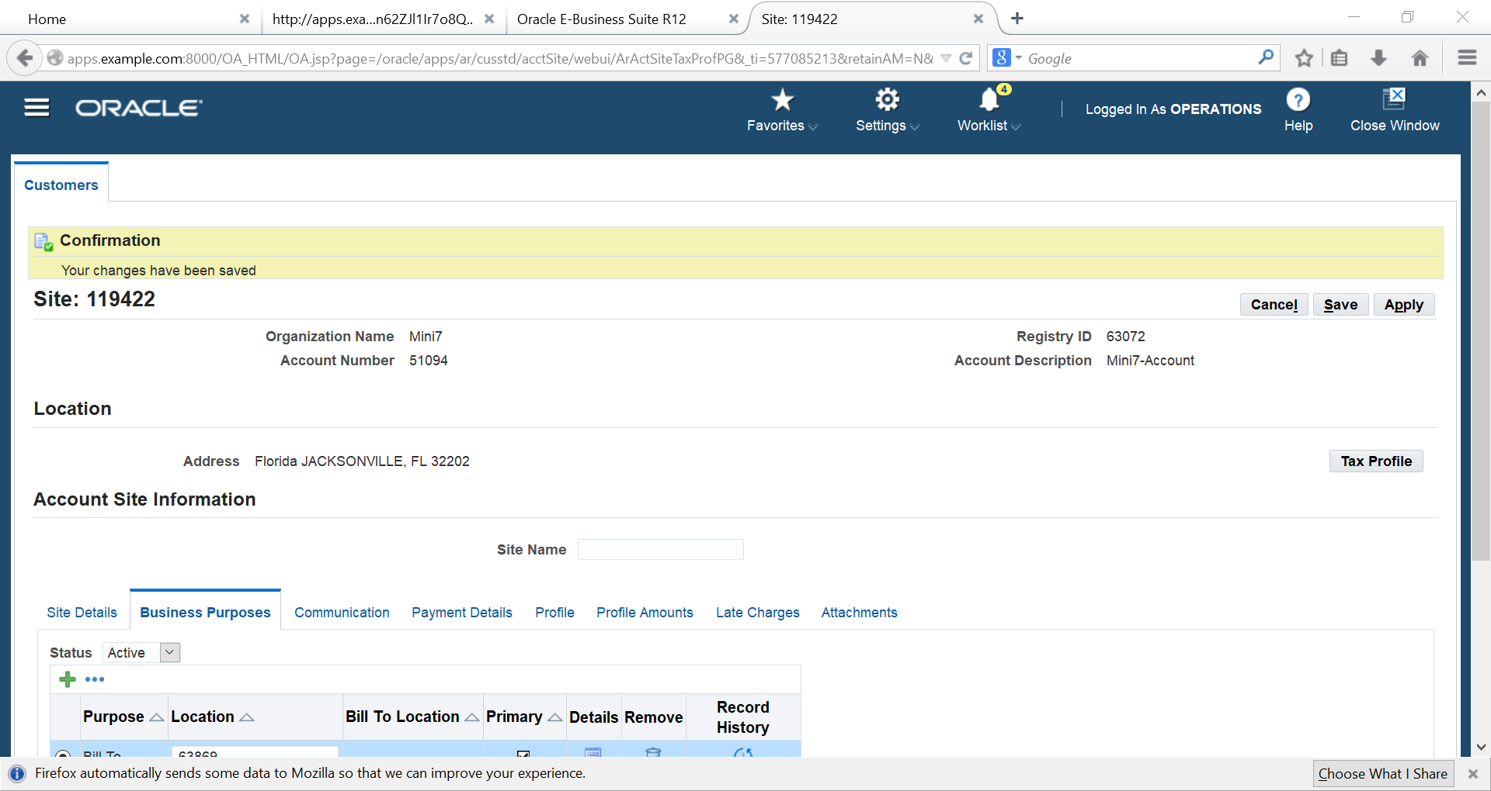
Profile

Slide 20
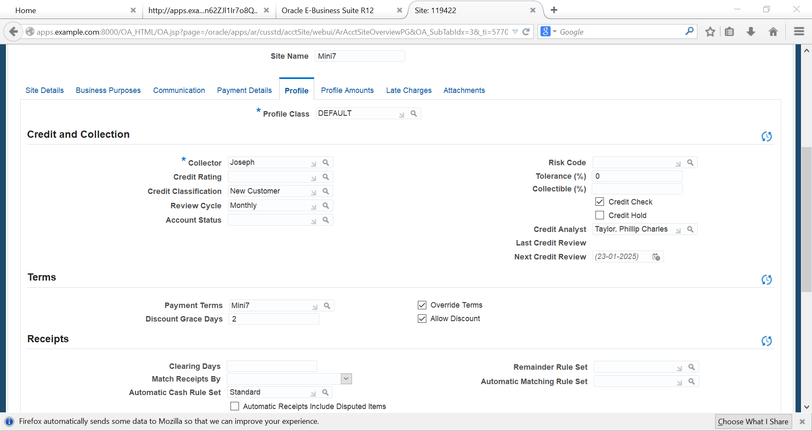
Choose our payment term

Slide 21
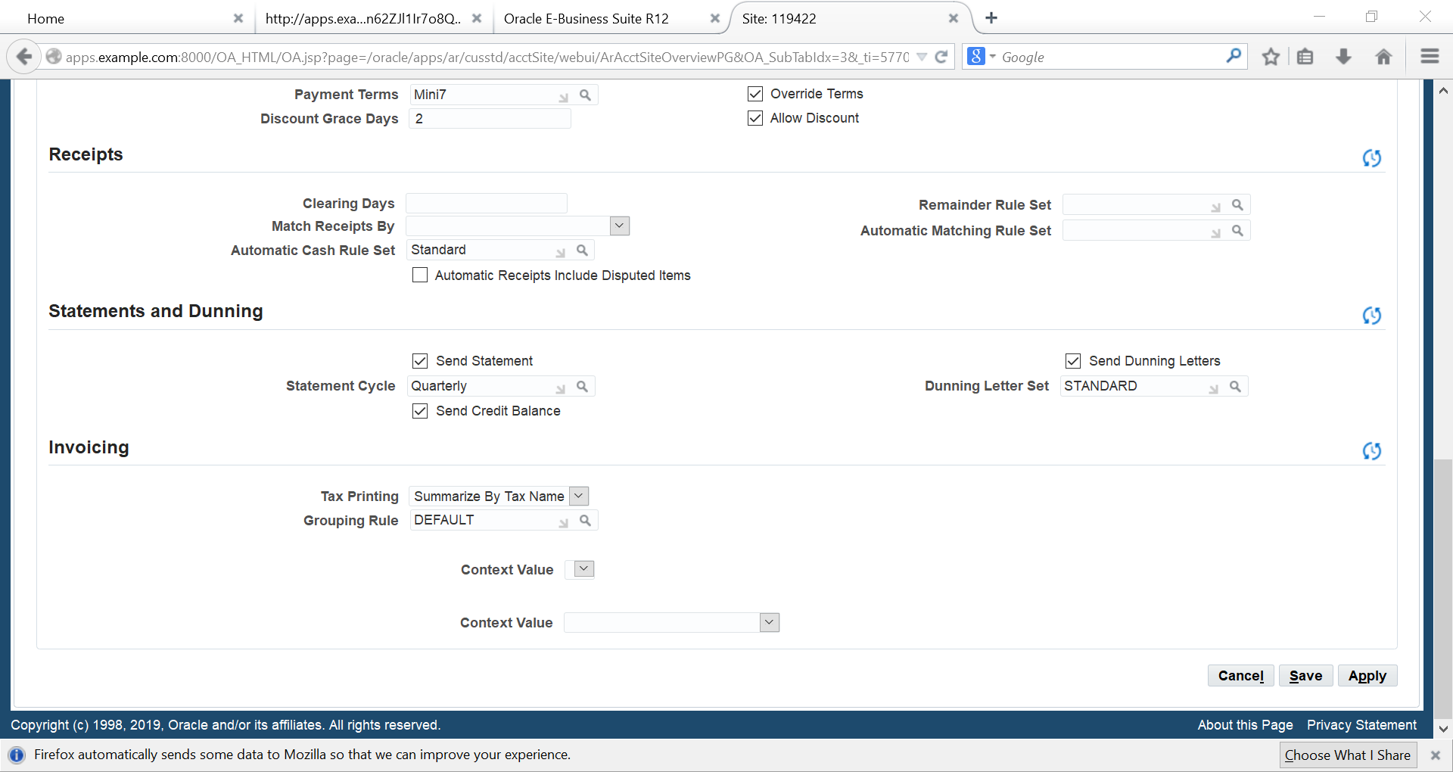
Click apply

Slide 22
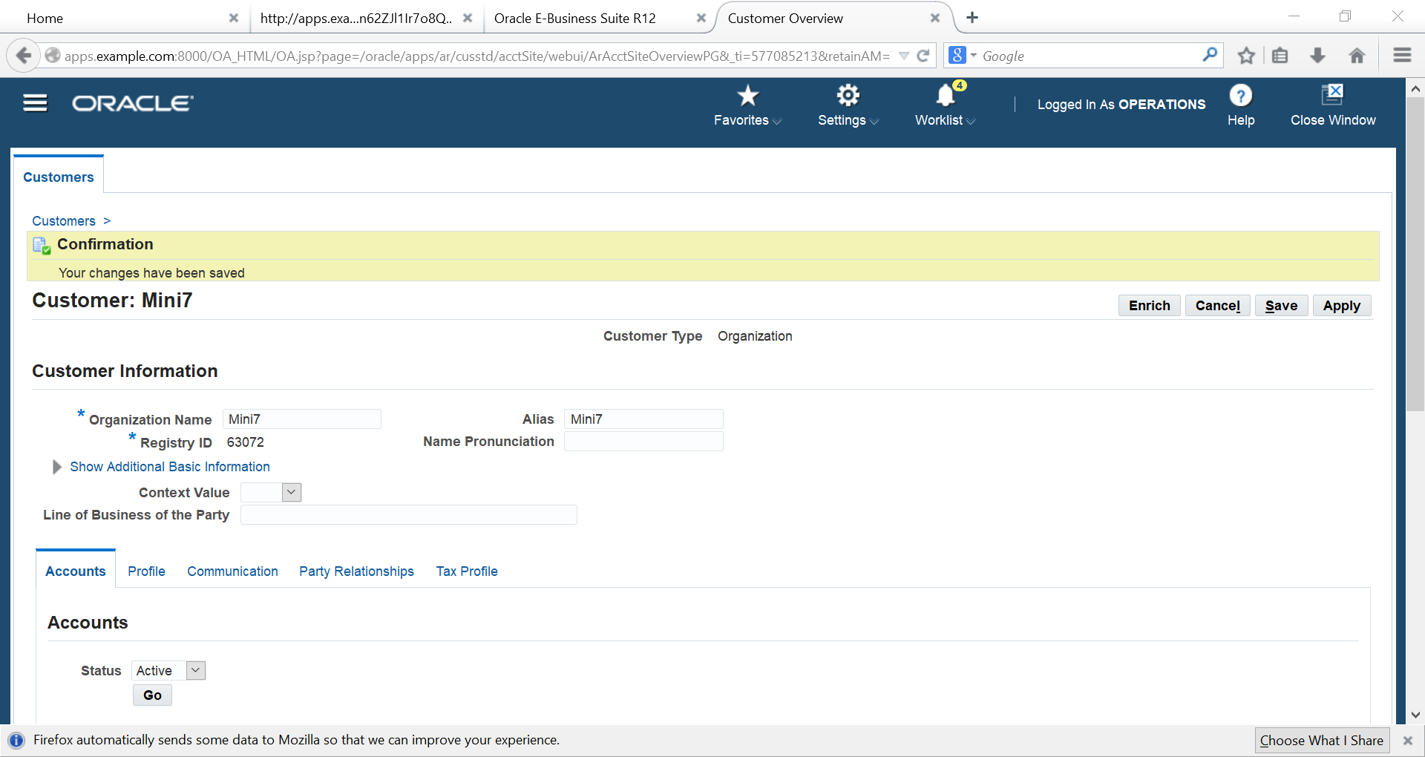
Here is our customer account & site

Slide 23
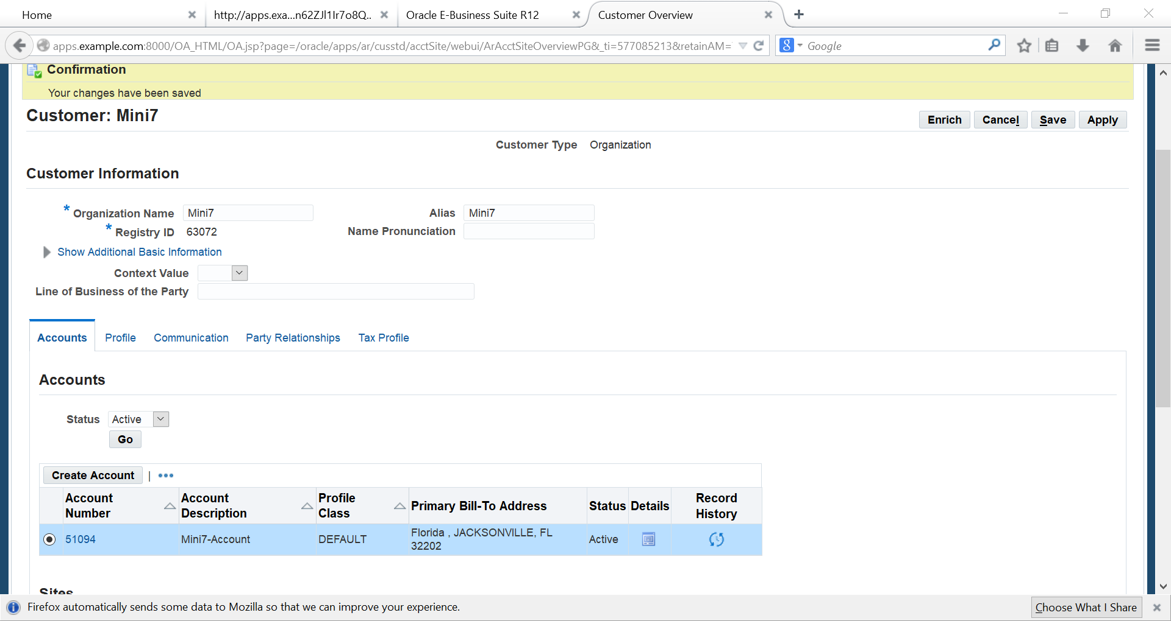

Slide 24
MEMO LINE

Slide 25
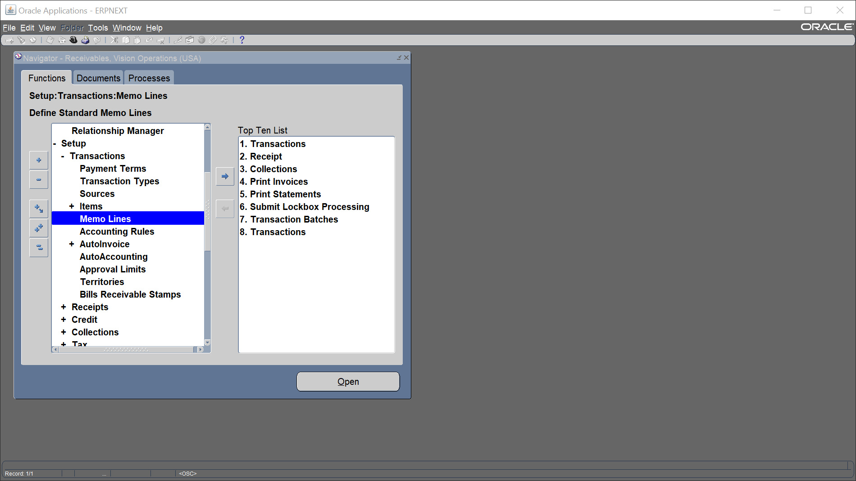
Memo Line
Setup
Transaction
Memo Lines

Slide 26
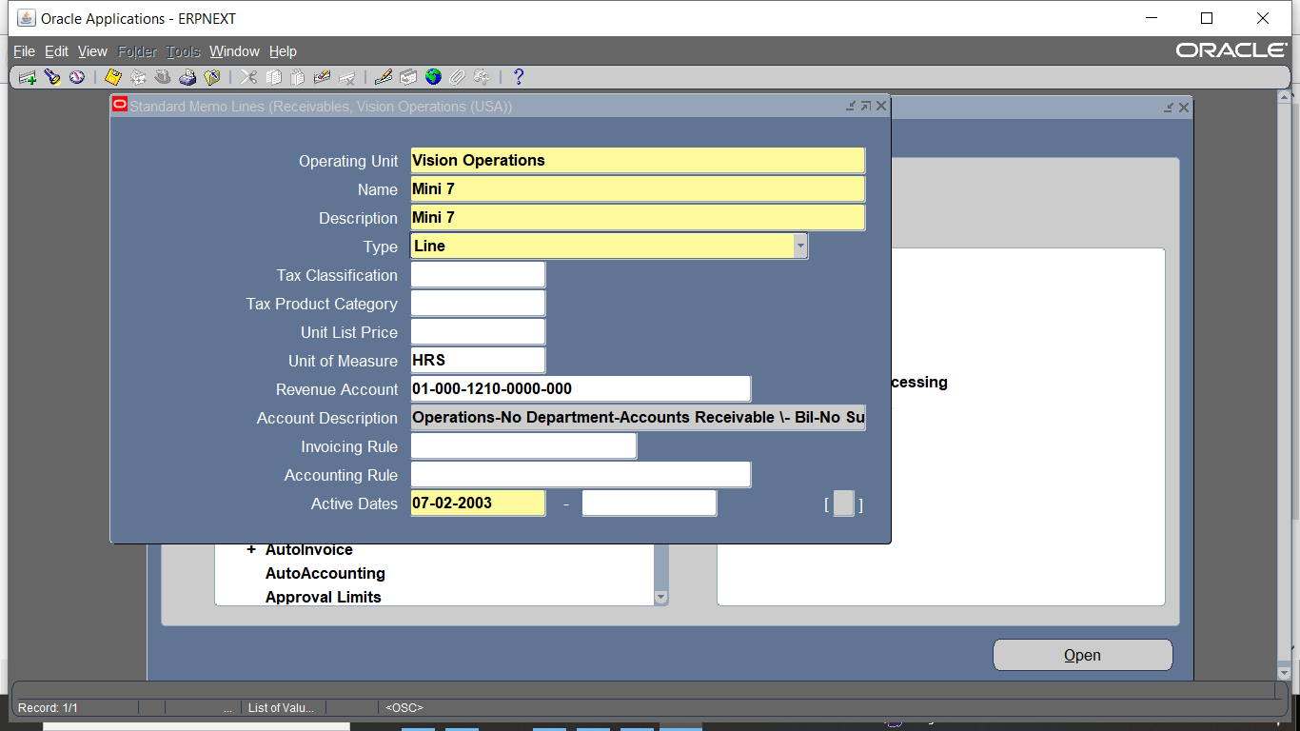
Add name . Description, Revenue ACC, active dates

Slide 27
Making invoice

Slide 28
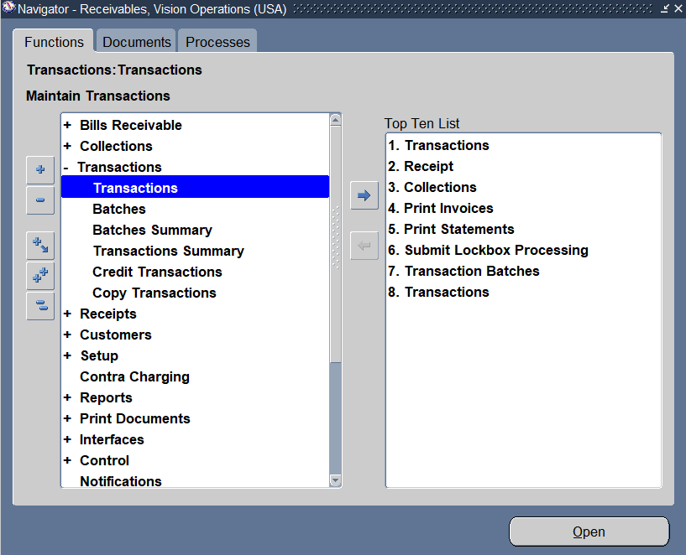
Making invoice
Transactions<<< Transactions

Slide 29
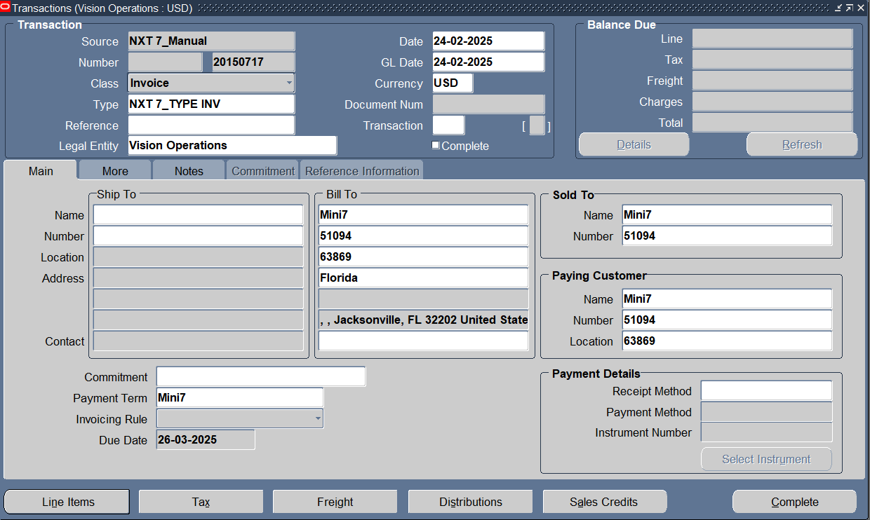
Enter Customer Info ,transaction class its type & tap line items to add transaction line

Slide 30
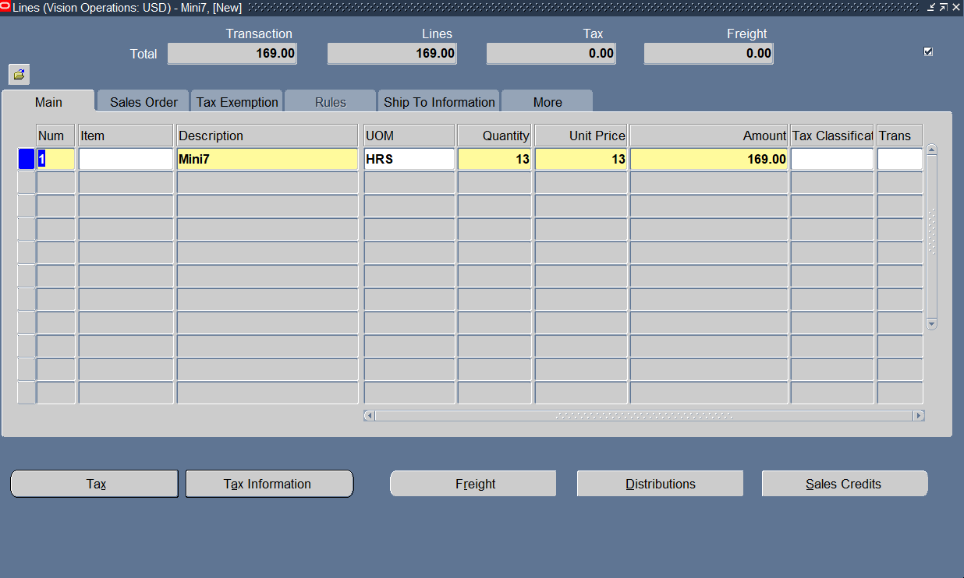
Add Transaction Line

Slide 31
Complete this transaction

Slide 32
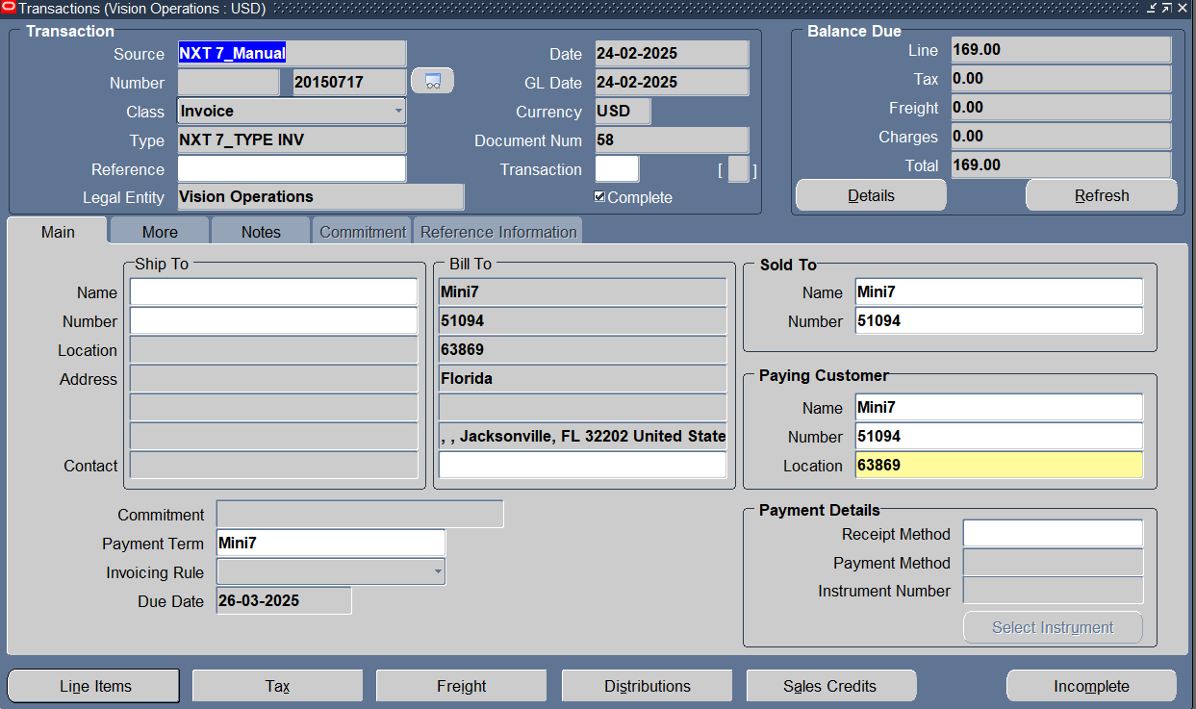
Transaction entry completed & we have a transaction number

Slide 33
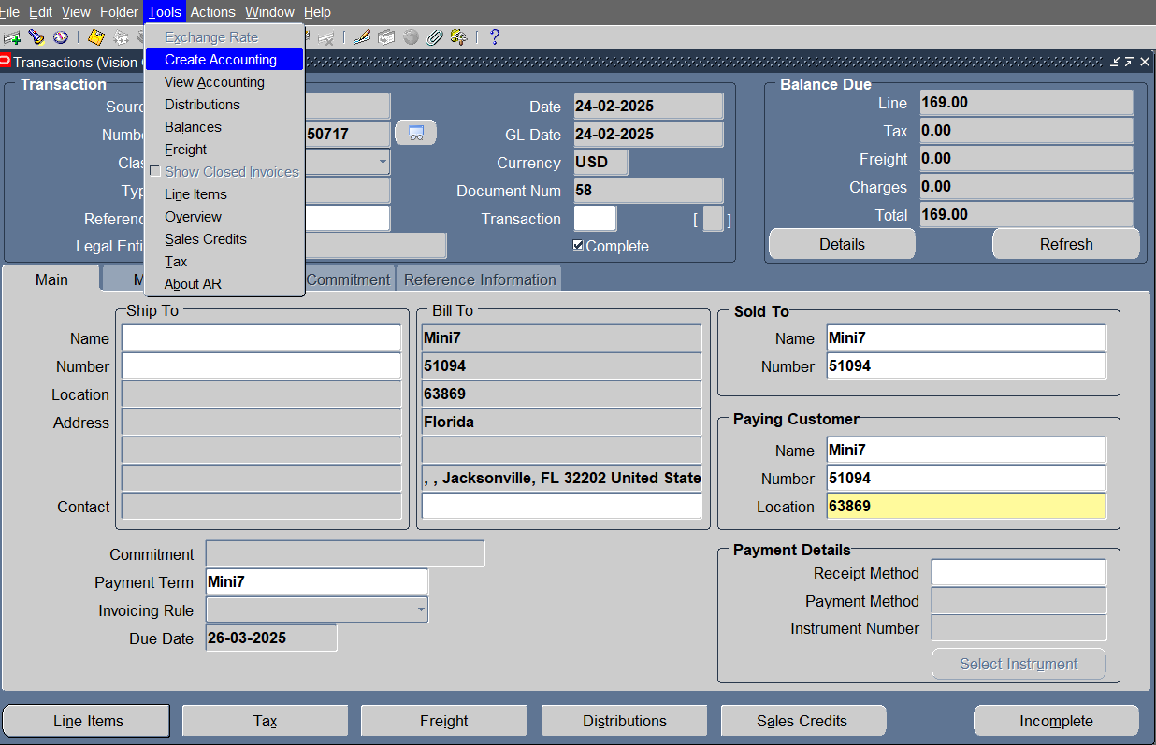
Creating accounting treatment

Slide 34
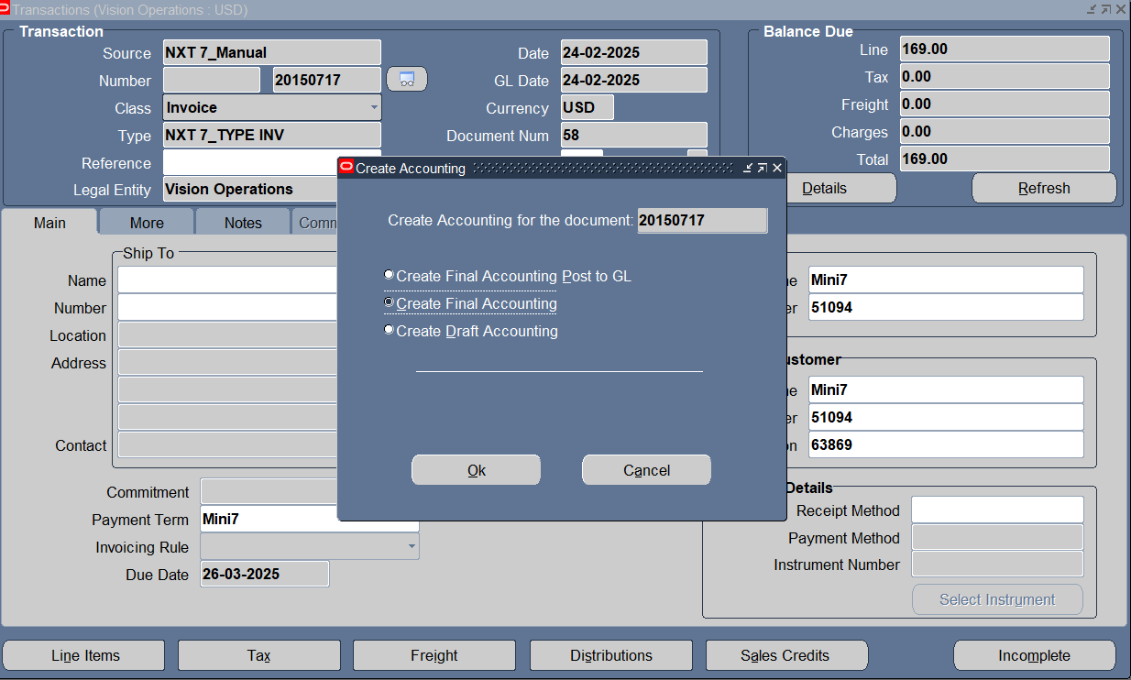
Create Final Accounting

Slide 35
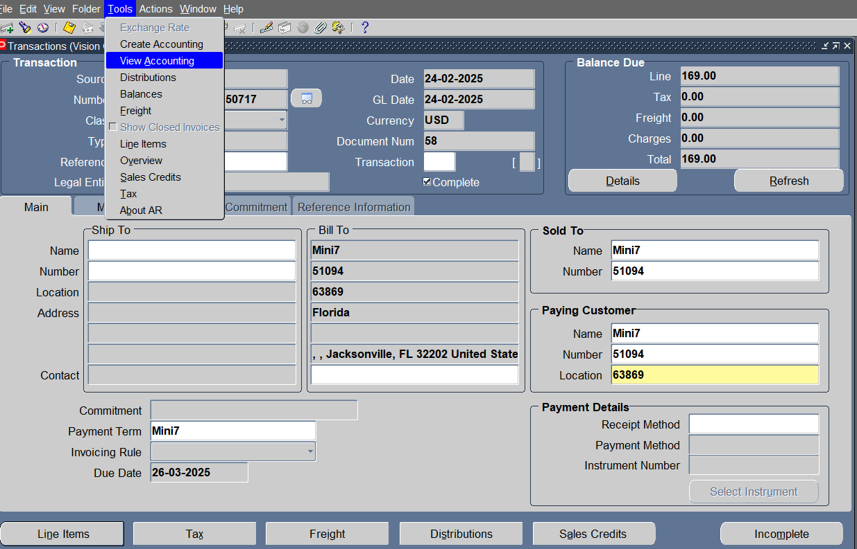
View accounting entry

Slide 36
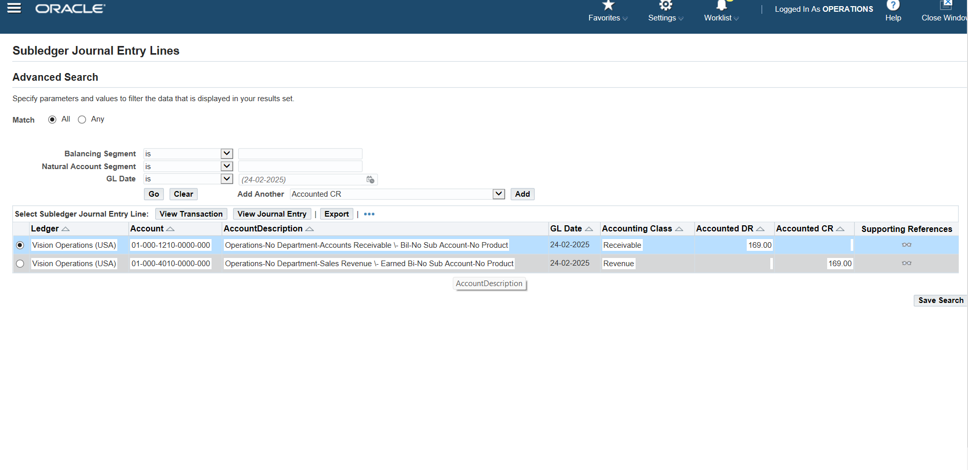
Transaction’s journal entry

Slide 37
Making cash invoice
Transactions<<< Transactions

Slide 38

Enter Customer Info ,transaction class its type , receipt method & tap line items to add transaction line

Slide 39
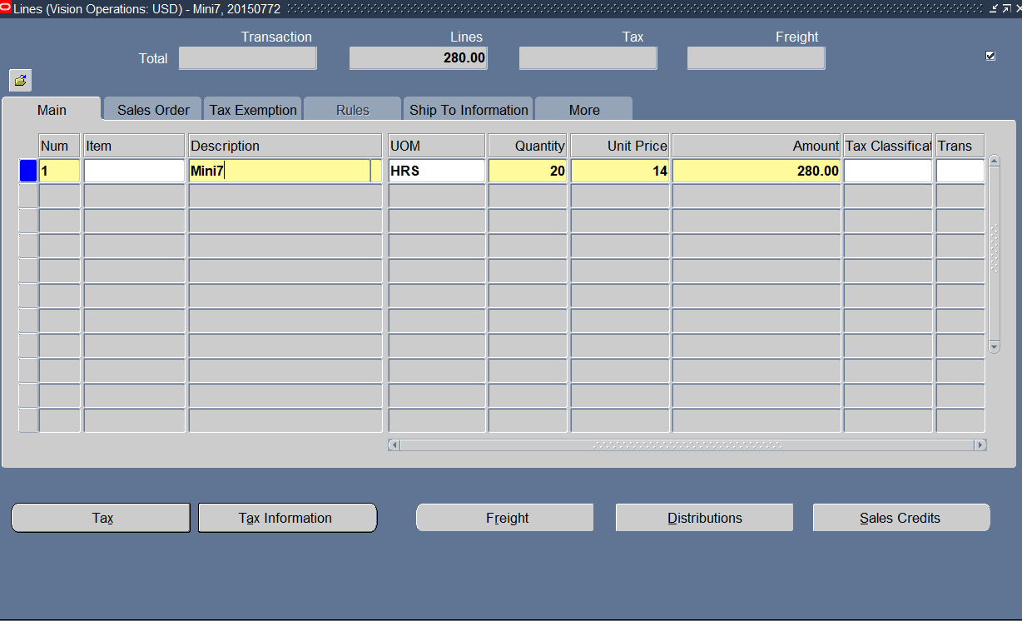
Add Transaction Line

Slide 40
Complete this transaction

Slide 41

Transaction entry completed & we have a transaction number

Slide 42
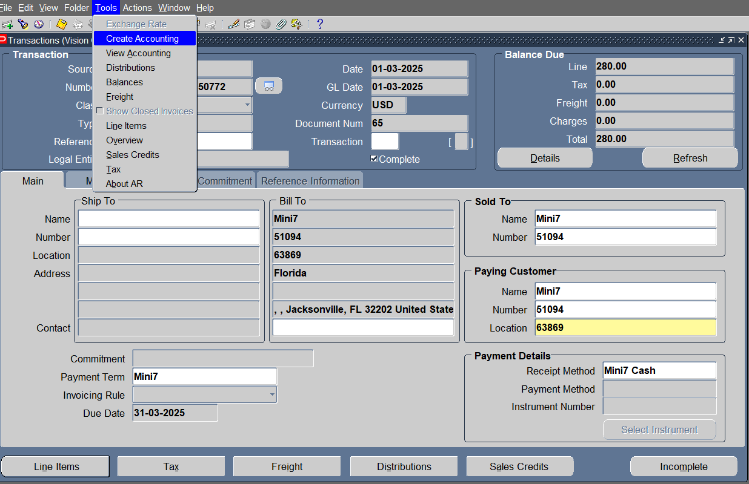
TOOLS> Create accounting

Slide 43
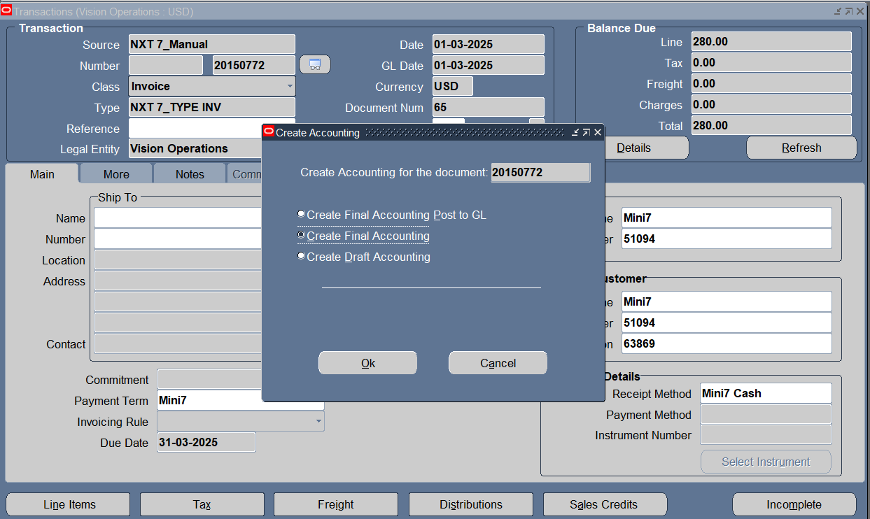
Create Final Accounting

Slide 44
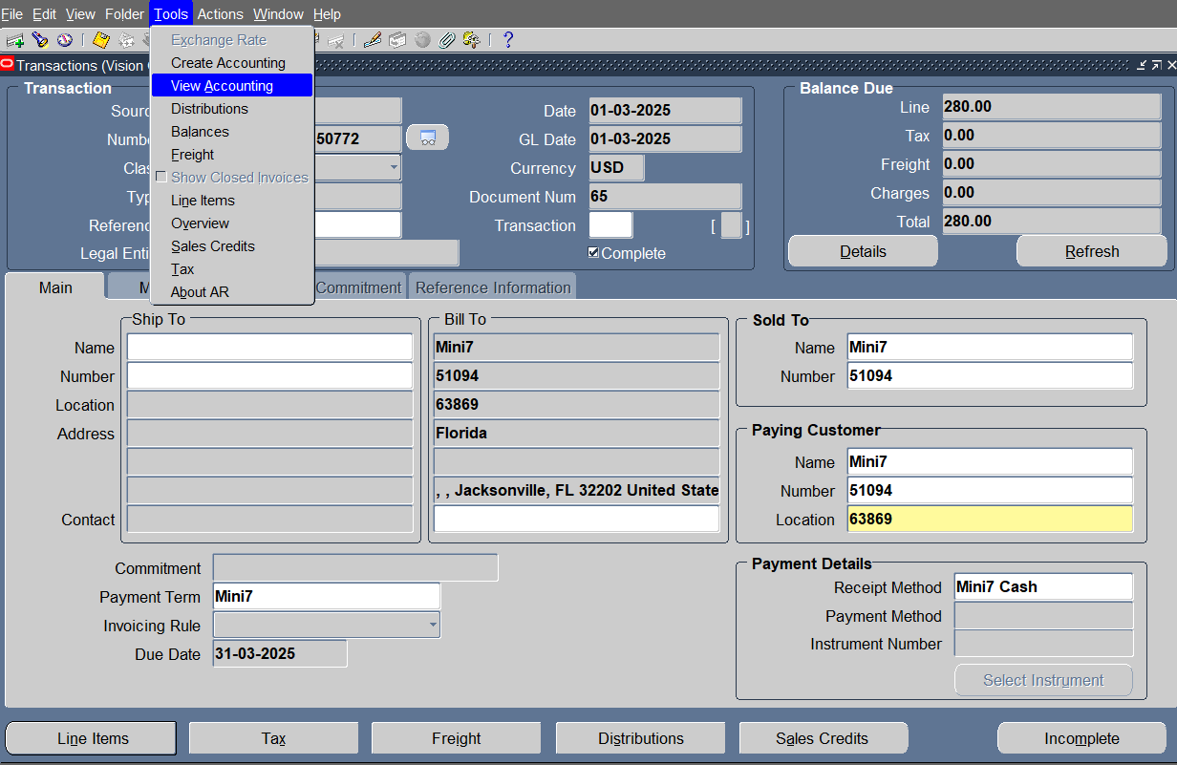
TOOLS >View accounting

Slide 45
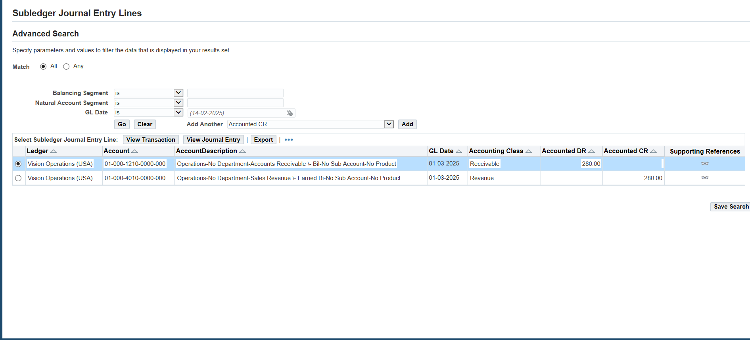
Transaction’s journal entry

Slide 46
Applying credit ON debit

Slide 47
Making debit memo
Transactions<<< Transactions

Slide 48
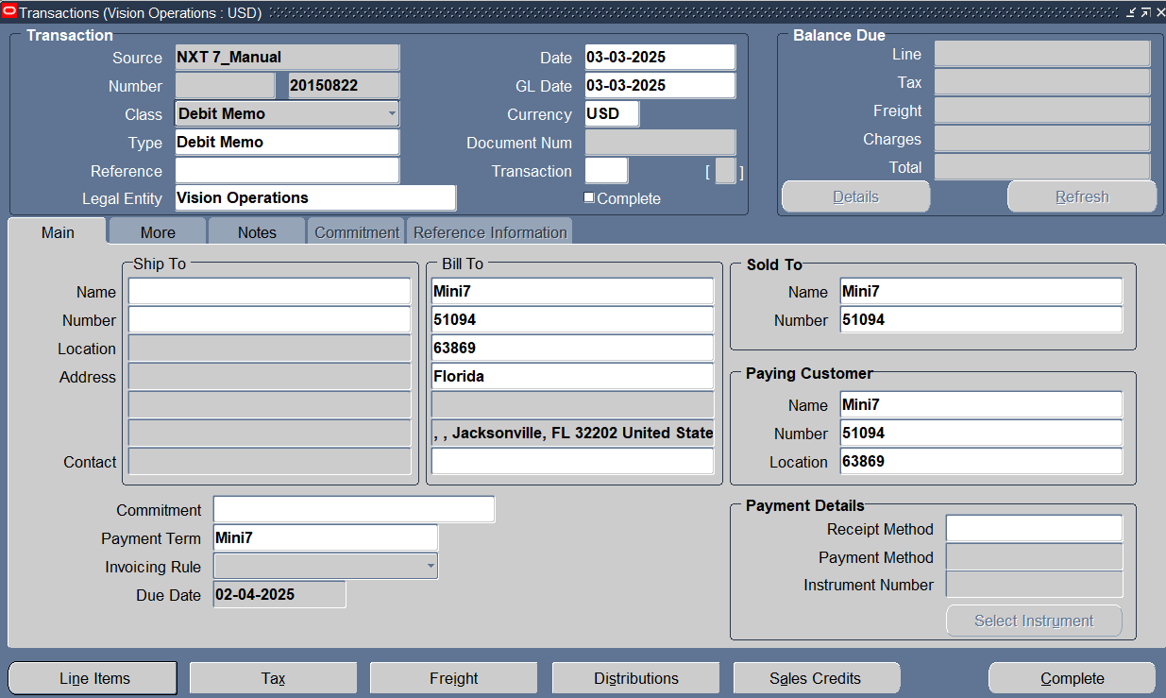
Enter Customer Info ,transaction class its type & tap line items to add transaction line

Slide 49
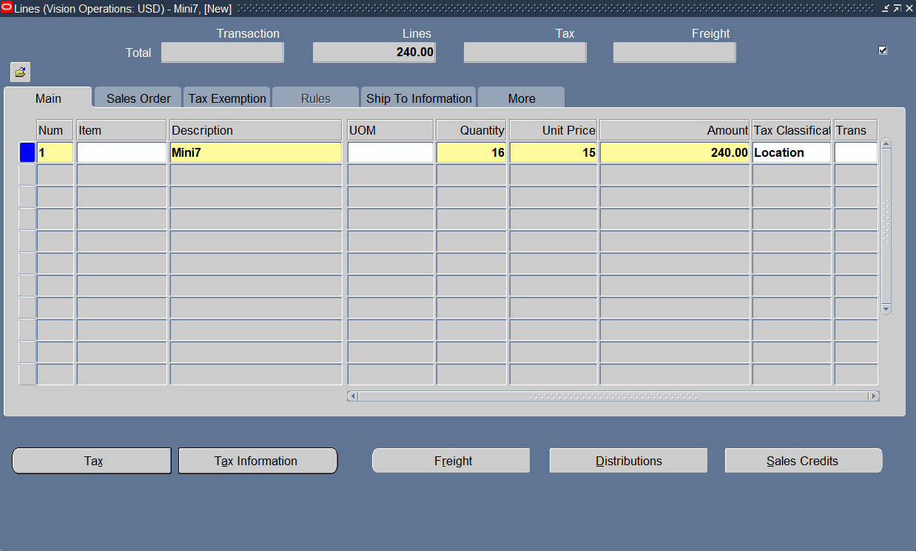
Add Transaction Line

Slide 50
Complete this transaction

Slide 51
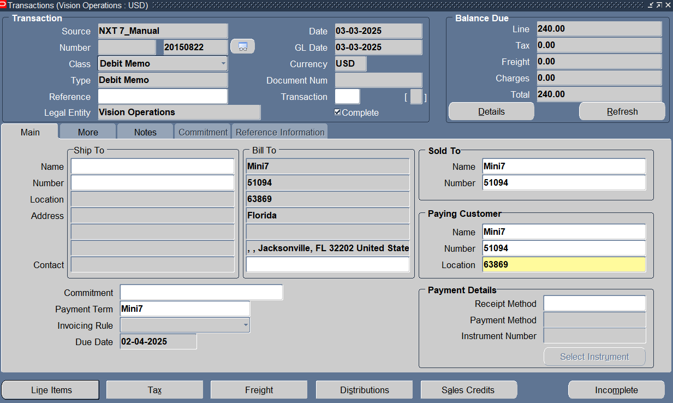
Transaction entry completed & we have a transaction number

Slide 52
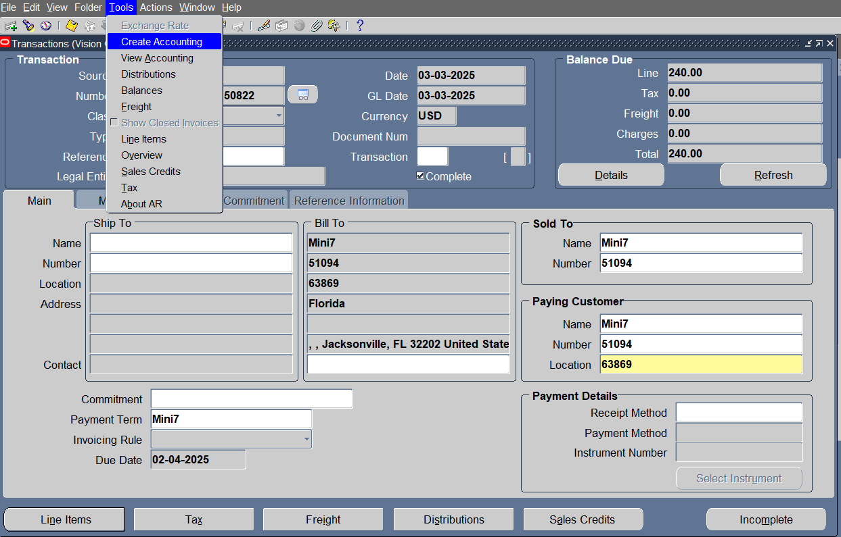
TOOLS> CreatE accounting

Slide 53
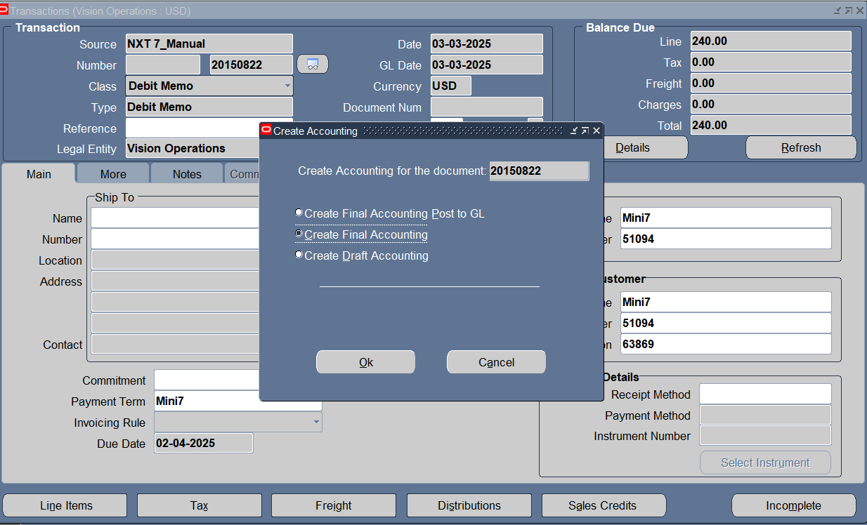
Create Final Accounting

Slide 54
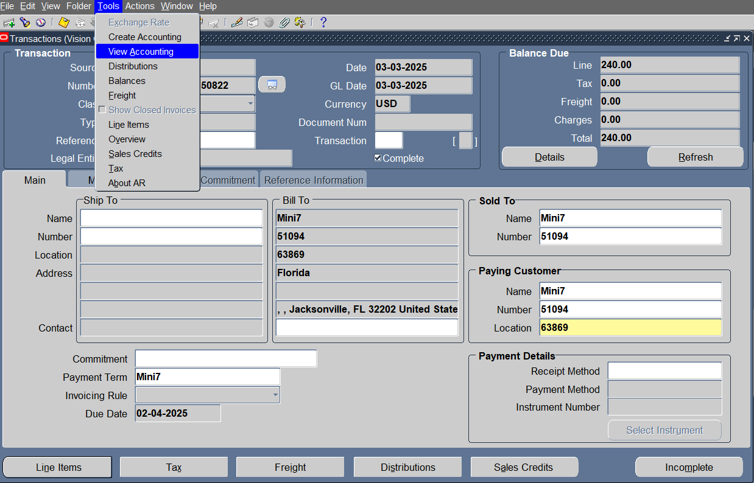
TOOLS >View accounting

Slide 55
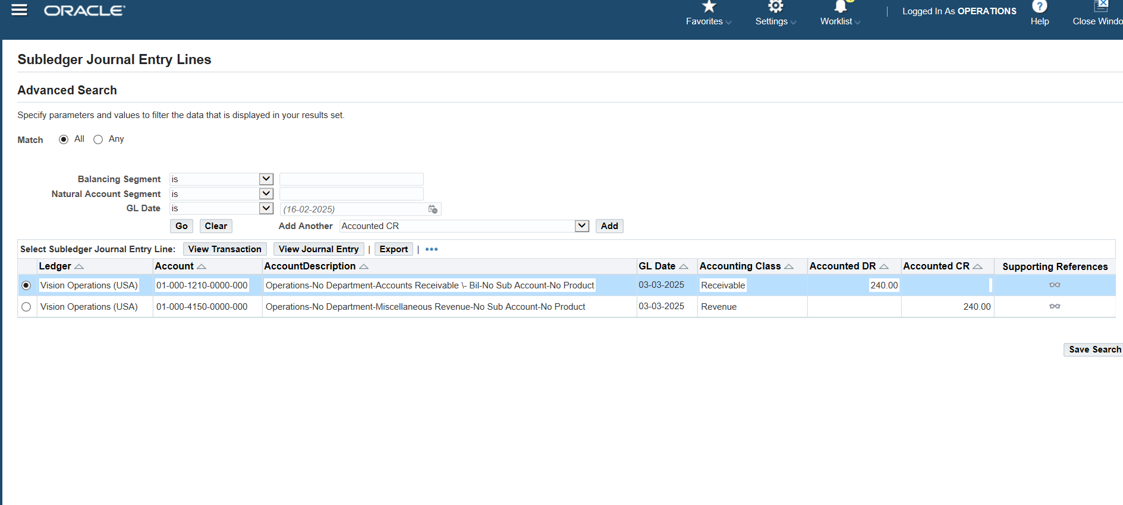
Transaction’s journal entry

Slide 56
Making credit memo
Transactions<<< Transactions

Slide 57
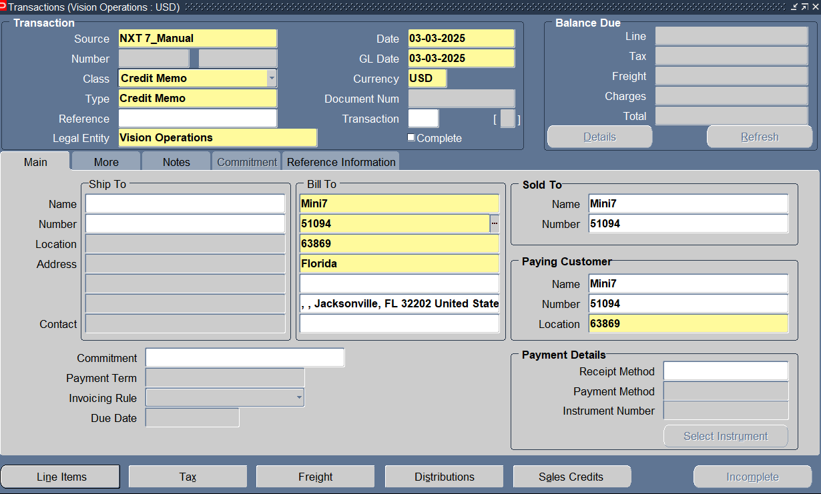
Enter Customer Info ,transaction class its type & tap line items to add transaction line

Slide 58
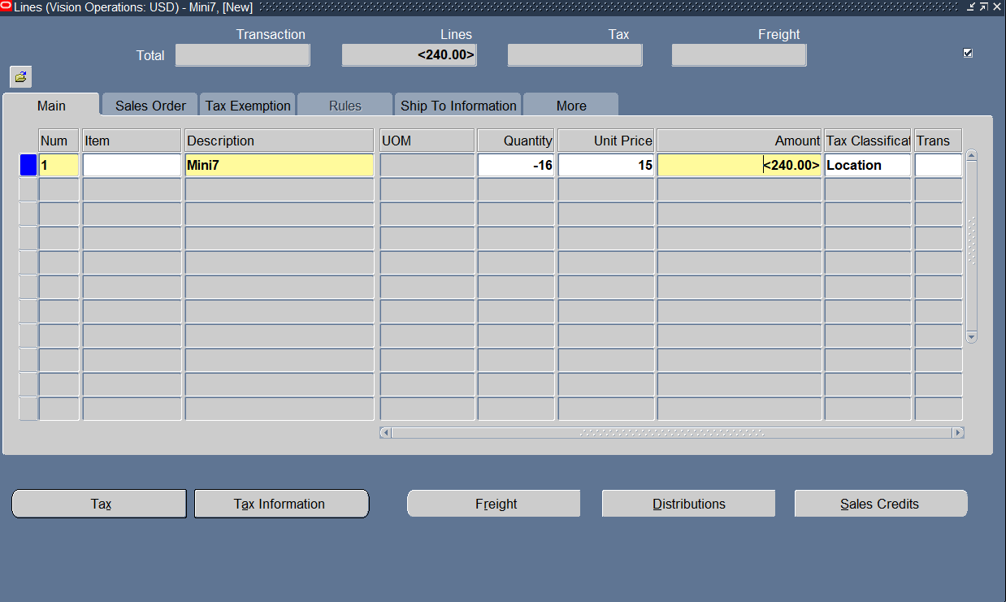
Add Transaction Line

Slide 59
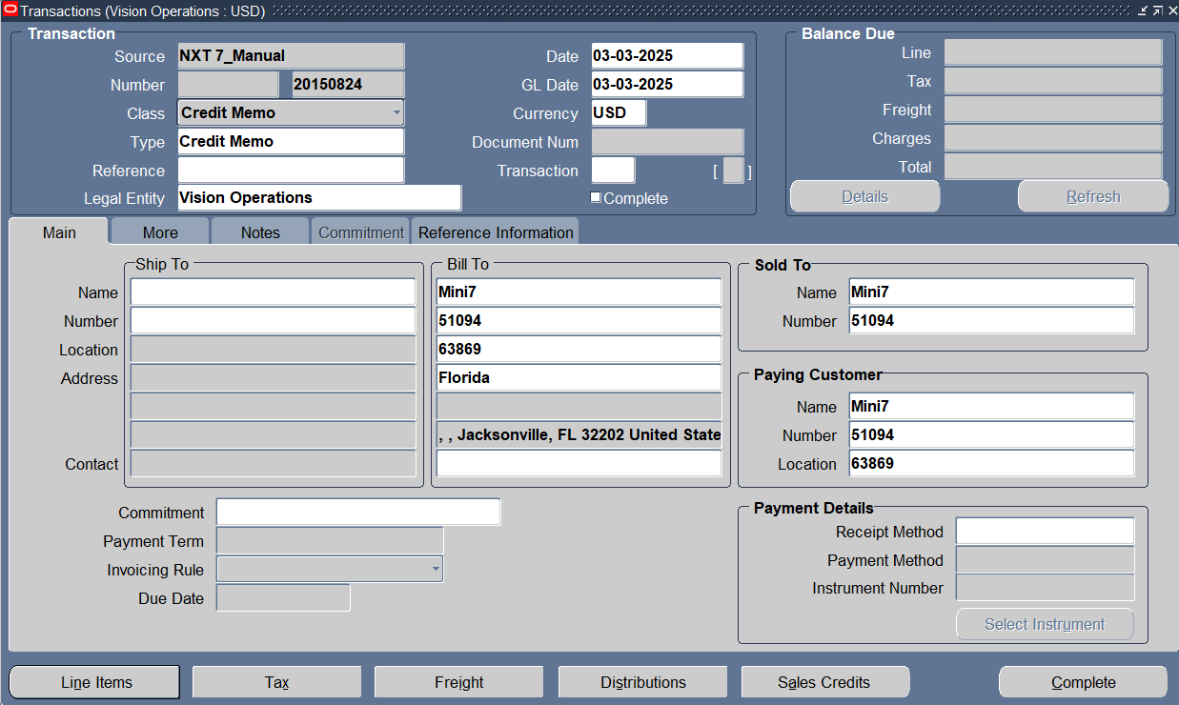
Complete this transaction

Slide 60
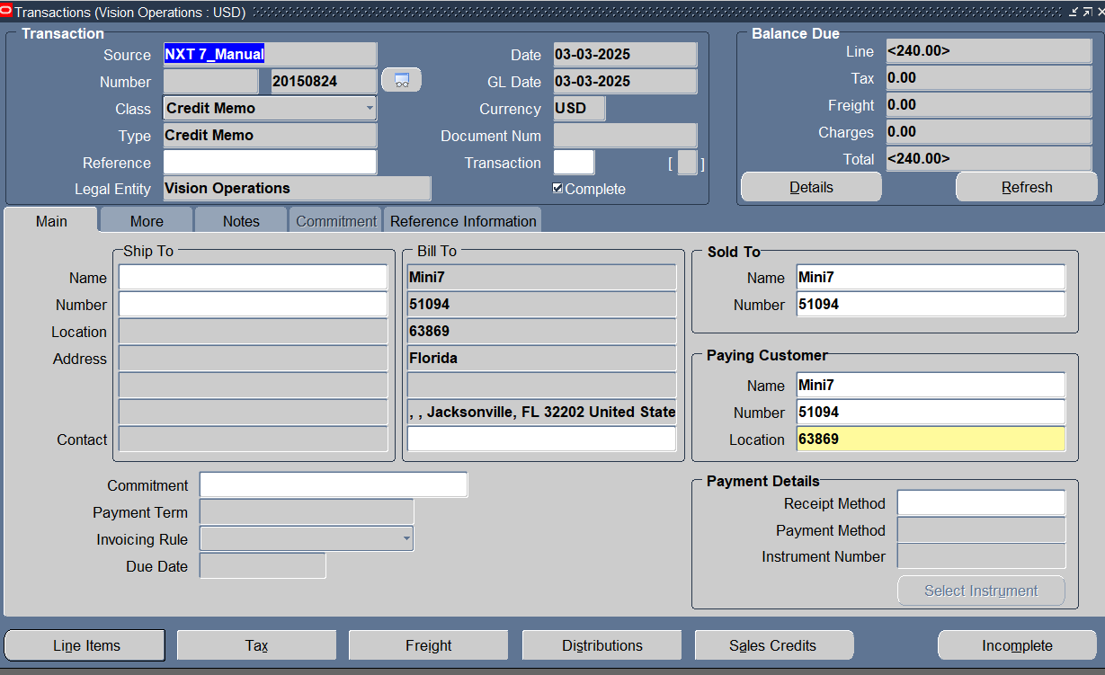
Transaction entry completed & we have a transaction number

Slide 61
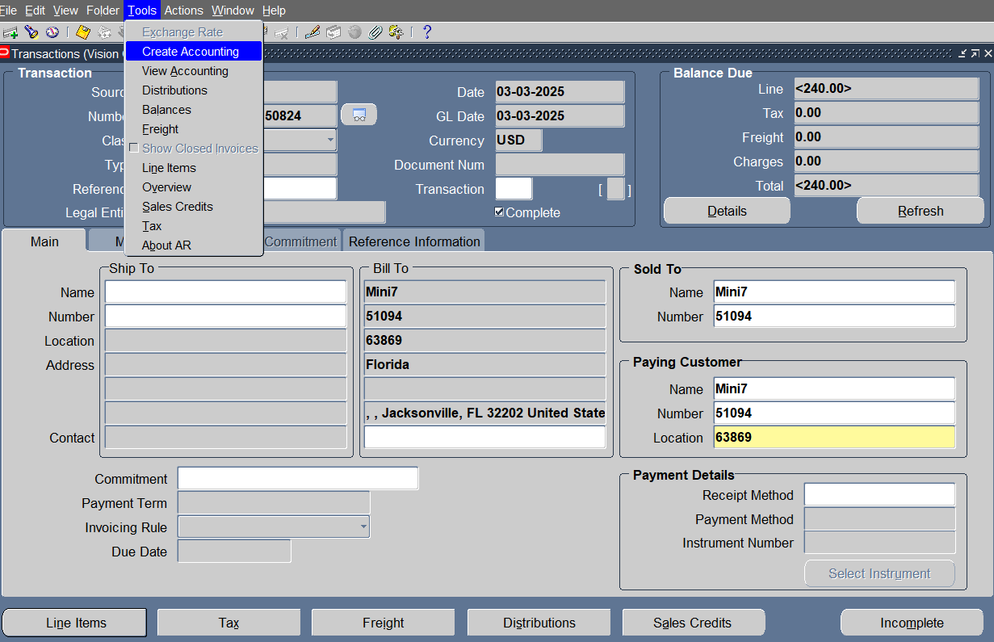
TOOLS > CreatE accounting

Slide 62
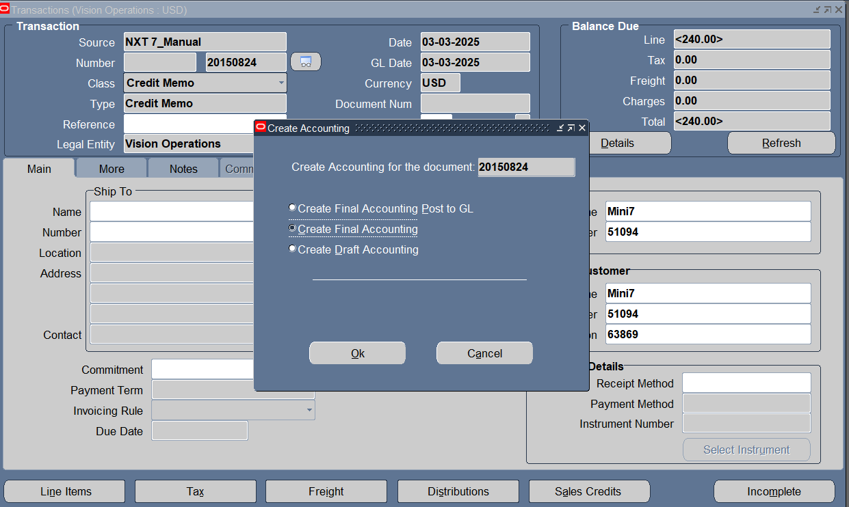
Create Final Accounting

Slide 63
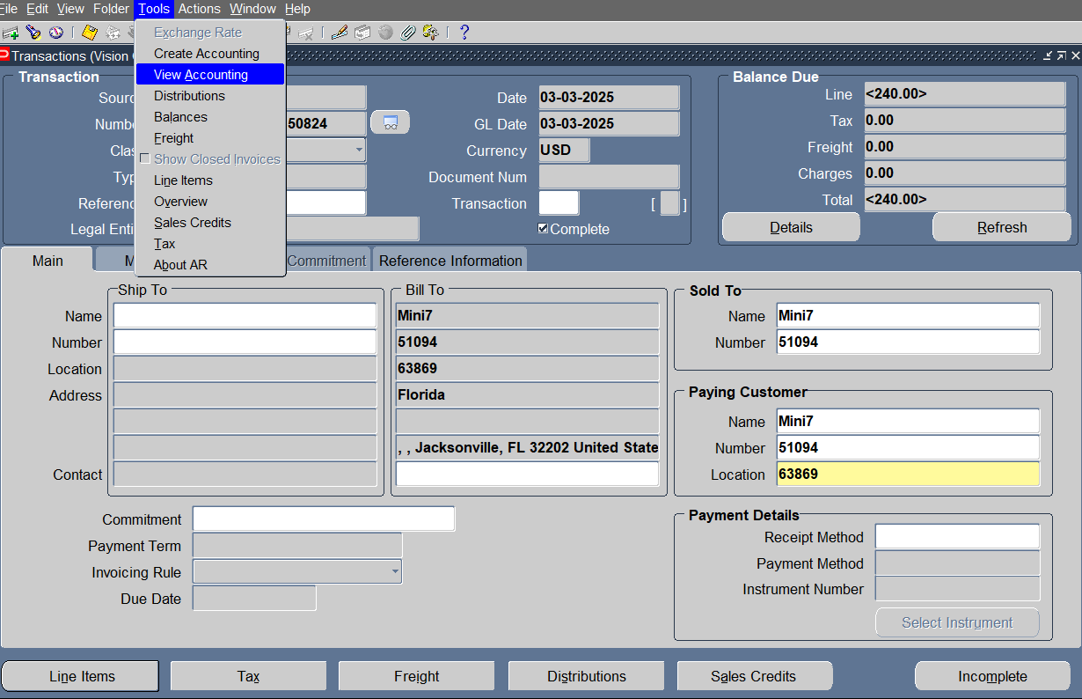
TOOLS > View accounting

Slide 64
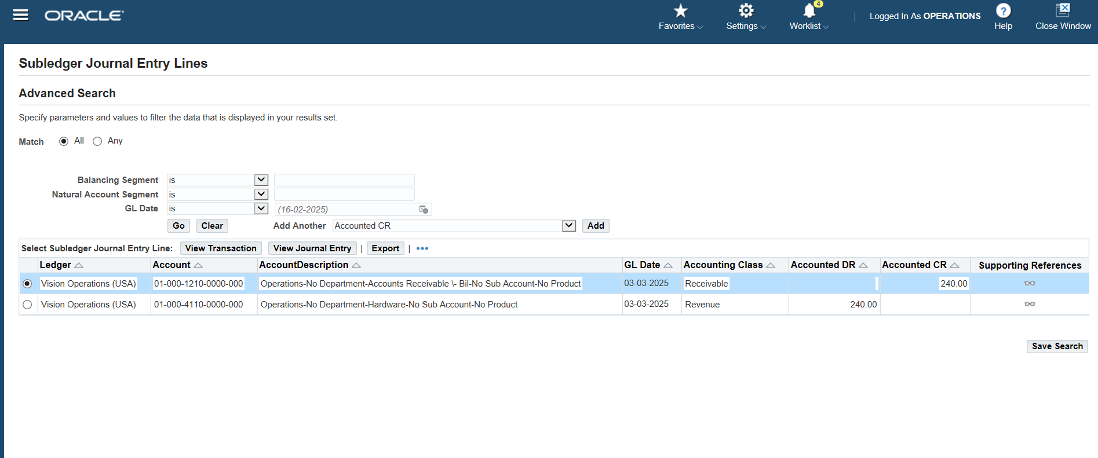
Transaction’s journal entry

Slide 65
Applying debit ON credit

Slide 66
Making credit memo
Transactions<<< Transactions

Slide 67

Enter Customer Info ,transaction class its type & tap line items to add transaction line

Slide 68
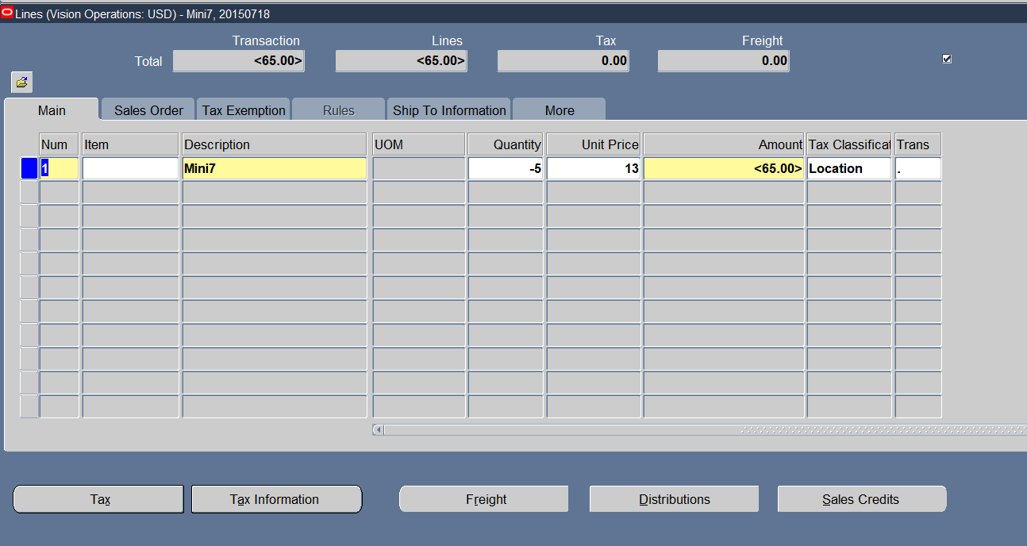
Add Transaction Line

Slide 69
Complete this transaction

Slide 70

Transaction entry completed & we have a transaction number

Slide 71

TOOLS> Create accounting treatment

Slide 72

Creating Final Accounting

Slide 73

TOOLS> View Accounting

Slide 74

Transaction’s journal entry

Slide 75
Making Debit memo
Transactions<<< Transactions

Slide 76

Enter Customer Info ,transaction class its type & tap line items to add transaction line

Slide 77

Add transaction Line

Slide 78
Complete this transaction

Slide 79

Transaction entry completed & we have a transaction number

Slide 80

TOOLS> Create accounting treatment

Slide 81

Create Final accounting

Slide 82

TOOLS> View AccountiNG

Slide 83

Transaction’s journal entry

Slide 84
Making Deposit
Transactions<<< Transactions

Slide 85

Enter Customer Info ,transaction class & its type

Slide 86

Enter commitment info

Slide 87

TOOLS >Create accounting treatment

Slide 88

Create Final Accounting

Slide 89

TOOLS> View Accounting

Slide 90

Transaction’s journal entry

Slide 91
Applying Deposit on standard
Transactions<<< Transactions

Slide 92
Enter Customer Info ,transaction class its type & tap line items to add transaction line

Slide 93

Add transaction Line

Slide 94

Transaction entry completed & we have a transaction number

Slide 95

Applying deposit on invoice ACTIONS> APPLY DEPOSIT

Slide 96

Enter the deposit info

Slide 97

The deposit was added and adjusted

Slide 98

The final balance

Slide 99

Tools> Creating accounting

Slide 100

Creating final accounting

Slide 101

TOOLS > View Accounting

Slide 102

Transaction’s journal entry

Slide 103

Enter Invoices Press Transactions > Transactions

Slide 104

Select the type of invoice, select the currency, enter the customer who makes an invoice for him, and select the payment term. Press Line Items

Slide 105

Enter in This Invoice the Type of line Items and amount

Slide 106

Press Complete

Slide 107

To Make this Invoice complete and transfer to the General ledger tools > create accounting Press Tools >> Create Accounting

Slide 108

Create Final Accounting >Ok
v

Slide 109

To show The transaction for this invoice Press Tools >> View Accounting

Slide 110

"Accounts receivable will be recorded as a debit, while revenue will be recorded as a credit."
v

Slide 111

Enter an invoice with items Transactions>>Transactions

Slide 112

"Enter the customer name, currency, Date, invoice type, and payment term." Press Line Items

Slide 113

"Enter '%%' in the Items field, press OK, and select the items."

Slide 114

Set the quantity for the item Specify the unit price of the item

Slide 115

Press complete

Slide 116

To Make this Invoice complete and transfer to the General ledger Tools >Create Accounting

Slide 117

Crate final Accounting >>Ok

Slide 118

To show The transaction for this invoice Press Tools >> View Accounting

Slide 119

"Accounts receivable will be recorded as a debit, while revenue will be recorded as a credit."

Slide 120

the same steps as before to enter the invoice Transactions>>Transactions

Slide 121

"Enter the customer name, currency, invoice type, and payment term." Press Line Items To Select Which Type of line items I Enter in This Invoice
v
v
v
v
v
v

Slide 122

Enter the Type of line Items and amount
v
v

Slide 123

Press Complete
v

Slide 124

To Make this Invoice complete and transfer to the General ledger Tools >Create Accounting

Slide 125

Crate final Accounting >>Ok
v
v

Slide 126

Tools > View Accounting

Slide 127

Show thetransaction for this invoice "Accounts receivable will be recorded as a debit, while revenue will be recorded as a credit."
v

Slide 128
Invoice Adjustments

Slide 129

Adjustment Any Invoices: 1. Enter the Approval limit: Setup>>Transactions >>Approval limit

Slide 130

Add a new approval limit so I can adjust invoices
v

Slide 131

v

Slide 132

Enter Receivable Activities to manage adjustments Press Setup>>Receipts>>Receivable Activities

Slide 133

Enter the Operating unit, Name, Type, and then Enter the Code Combination
v
v
v
v
v

Slide 134
Search for invoices to adjust Transactions >> Transactions Select the Invoice and adjust it

Slide 135

Enter the Transactions Number and press find
v

Slide 136

Actions > Adjust

Slide 137

Select That Invoice I need to Adjust And Press Adjust
v
v

Slide 138

Select the Activity Name I entered in Receivable Activities, type, and the amount I need to adjust.
v
v
v

Slide 139

create accounting on the adjustment screen. Press Tools >> Create Accounting

Slide 140

Create Final Accounting>>Ok
v
v

Slide 141

Tools >View Accounting

Slide 142

show impacts on the customer’s account balance. Record the adjustment as a debit because it reduces the invoice by the same amount. This also decreases the receivables, which should be reflected as a credit
v

Slide 143

Press Details
v
v

Slide 144

show the adjustments that happened in the invoice
v
v
v

Slide 145
Search for another invoice to adjust Transactions > Transactions Select the Invoice and adjust it

Slide 146

Enter the Transactions Number and press find
v

Slide 147

"I will adjust to add an amount to the customer's invoice." Actions >> Adjust

Slide 148

Select the Activity Name I entered in Receivable Activities, type, and the amount that I need to adjust
v
v
v

Slide 149

And create accounting on the adjustment screen. Tools > Create Accounting

Slide 150

Create Final Accounting>>Ok
v
v

Slide 151

Tools >View Accounting

Slide 152

show impacts on the customer’s account balance. "Record the adjustment as a credit because it increases the invoice by the same amount. This also increases the receivables, which should be reflected as a debit."
v

Slide 153

Press Details
v
v

Slide 154

show the adjustments that happened in the invoice
v
v
v

Slide 155
CREATE BANK

Slide 156

Create Bank
Setup
Payment
Bank and Bank Branches

Slide 157

Create

Slide 158

Create New Bank

Slide 159

Create Bank Branch

Slide 160

Create account

Slide 161

Create bank account Setup > payment > bank account

Slide 162

create

Slide 163

Search with bank name > continue

Slide 164

vision operations > receivables > next

Slide 165

Add account name and number

Slide 166

Add cash & cash clearing accounts

Slide 167

Continue

Slide 168

Add Accounts, Apply

Slide 169


Slide 170
Create bank saFe box

Slide 171
Create Bank saFe box
Setup
Payment
Bank and Bank Branches

Slide 172

create

Slide 173

Create New Bank

Slide 174

create

Slide 175

Create bank branch > create

Slide 176

Search with bank name > continue

Slide 177

Create new Branch

Slide 178

Our bank branch is done

Slide 179
Create bank account Setup > payment > bank account

Slide 180
create

Slide 181
Search with our bank name

Slide 182

Create Bank account

Slide 183

Add account name & number

Slide 184

Add cash & cash clearing accounts

Slide 185

Save and next

Slide 186

Click continue

Slide 187

Add accounts & apply

Slide 188

Here is our bank

Slide 189


